Slide 1

NOIDA INSTITUTE OF ENGINEERING & TECHNOLOGY GREATER NOIDA
Course:- B. Tech & Branch:- CSE, DS, AI, AIML, IoT Subject Name:- Finance For Engineers Subject Code:-AOE0770
Lecture – (1-8) UNIT-2
By
Name of Faculty:- Ms Sonali Sharma
Designation:- Assistant Professor
Department:- MBA Department
NIET, GREATER NOIDA

Slide 2

Index/Content
S. No. | Index
1. | Name of Subject with code, Course and Subject Teacher
2. | Brief Introduction of Faculty member with Photograph
3. | Evaluation Scheme
4. | Syllabus
5. | Branch wise Application
6. | Course Objective(s)
7. | Course Outcome(s)
8. | Program Outcomes (POs)
9. | Cos and POs Mapping

Slide 3
Index/Content
S. No. | Index
10. | Program Specific Outcomes (PSOs)
11. | Cos and PSOs Mapping
12. | Program Educational Objectives (PEOs)
13. | Result Analysis
14. | End Semester Question paper Templates
15. | Prequisite/Recap
16. | Brief Introduction about the Subject with Videos
17. | Unit Contents
18. | Unit Objectives
19. | Topic Objectives/Topic Outcome

Slide 4
Index/Content
S. No. | Index
20. | Lecture related to topic
21. | Daily Quiz
22. | Weekly Assignment
23. | Topic Links
24. | MCQs
25. | Glossary Questions
26. | Old question papers
27. | Expected Questions
28. | Recap of unit

Slide 5


Noida Institute of Engineering and Technology, Greater Noida
Ms Garima Singhal
Assistant Professor
Department: Management Studies (MBA)
Email ID: garima.singhal@niet.co.in
Qualification: Diploma (CSE), B.Tech (CSE), M Tech (CS),
MBA
Specialisation: Information Technology & Finance

Slide 6
Syllabus
Course Contents / Syllabus
UNIT-I Basics of Accounting Hours- 9
Basics of Accounting: Principles of Accounting, Concept of debit & credit, Books of accounts, Journal, Ledgers, Basic Accounting terminologies, Overview to Deprecation (straight line and diminishing method)
UNIT-II Financial Statements Analysis Hours-9
Financial Statements: Income statement & Position statement: Preparation and analysis of Key financial ratios, their interpretation, comparison of ratio with competition to identify improvement areas

Slide 7
Syllabus
UNIT-III Project Finance Hours-8
Appraisal of projects: Techniques, Finance for Startups- Govt Schemes / PSU &PSE Bank Finance, Bank Scrutiny for approvals etc., Project Budgeting, Capex, Opex and Importance of tracking cost of projects in execution,
UNIT-IV Working Capital Management Hours-8
Concepts of Working Capital and its types, Approaches to working capital, Inventory management: Nature, Objective, Techniques of inventory management, Cash Management: Objectives, preparation of Cash Flow Statement and its analysis.

Slide 8
Syllabus
UNIT-V Financial Products & Services Hours-6
Introduction to Personal Financial Portfolio Management, Key Options of Savings &Investment – Debt, Equity, etc. Brief Introduction to Mutual Funds and Stock Market

Slide 9
Course Objectives
1 | Familiarize students with basic financial accounting concepts & process | CO1
2 | Develop analytical skills for financial analysis | CO2
3 | Develop capacity to apprise projects and their financing along with solving various issued related to inventory and cash | CO3
4 | Understand and construct personal saving and investment portfolios | CO4

Slide 10
Branch wise Applications
Financial accounting can be used in short-term and long-term decisions involving the financial health of a company.
Financial accounting helps managers make operational decisions–intended to help increase the company's operational efficiency–which also helps in making long-term investment decisions.
Forecasting, monitoring, and tracking performance is a critical aspect of managerial accounting to ensure actual results meet the budgets and forecasts outlined at the onset.
Financial accounting is the type of accounting that provides financial information to top and middle level management in a company.
Financial accounting often involves various financial metrics, including revenue, sales, operating expenses, and cost controls.
Financial accounting helps companies plan, forecast, and budget at an enterprise-wide level to ensure the company's long-term success.

Slide 11
Session Learning Objectives
Students will be able to know the following concepts:
Introduction & Meaning of Ratio Analysis
Usefulness of Ratio Analysis
Limitations of Ratio Analysis
Classification of Ratios
Income statement & Position statement
Preparation and analysis Key financial ratios
Interpretation, comparison of ratio with competition to identify improvement areas

Slide 12
Objective of Unit
To understand the ratios.
To understand the trend analysis.
To understand the caparison of financial statement.

Slide 13
Course Outcome
CO1: Understand and apply accounting concepts, principles and conventions for their routine monetary transaction.
CO2: Applying planning and managerial decision-making skills.
CO3: Develop analytical and problem solving skills based on an understanding of management concepts and theories
CO4: Comprehend and practice Indian Ethos and Value Systems.
CO5: Applying value-based management and ethical practices.

Slide 14
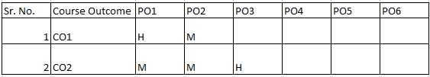

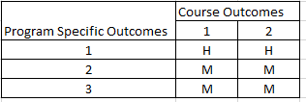
CO-PO Mapping
Mapping of Course Outcomes and Program Outcomes
Mapping of Program Specific Outcomes and Course Outcomes

Slide 15
CO-PO and PSO Mapping
Unit | So. No. | Mapping
 |  | CO | Level | PO | Level
II | 1 | 3 | High | 2 | Medium
 | 2 | 4 | Medium | 4 | High
 | 3 | 5 | High | 5 | High

Slide 16
Recap
Overall we learn following aspects in previous Unit 2:
Rules of journal entries
Ledger
Financial statement

Slide 17
Financial Statements
Financial statements provide the fundamental information we use to analyse and answer valuation questions. It is important, therefore, that we understand the principles governing these statements by looking at four questions:
• How valuable are the assets of a firm? A firm’s assets can come in several forms – assets with long lives, such as land and buildings; assets with shorter lives, such as inventory; and intangible assets that still produce revenues, such as patents and trademarks.
• How did the firm raise the funds to finance these assets? In acquiring these assets, firms
can use the funds of the owners (equity) or borrowed money (debt), and the mix is likely to change as the assets age.
• How profitable are these assets? A good investment, we argued, makes a return greater than the hurdle rate. To evaluate whether the investments that a firm has already made are good investments, we need to estimate what returns we are making on these investments.
• How much uncertainty (or risk) is embedded in these assets? While we have not directly
confronted the issue of risk, yet estimating the uncertainty in existing investments and the implications for a firm is clearly a first step.
We will look at how accountants answer these questions and why the answers might be different when doing valuation. Some of these differences can be traced to the differences in objectives—accountants try to measure a firm’s current standing and immediate past performance, whereas valuation is much more forward-looking.

Slide 18
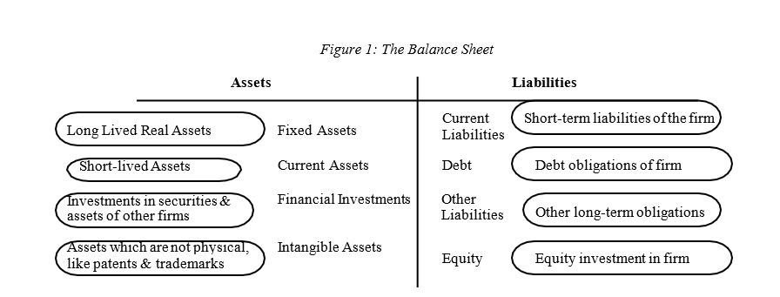
The Basic Accounting Statements
There are three basic accounting statements that summarize information about a firm. The first is the balance sheet, which summarizes the assets owned by a firm, the value of these assets and the mix of financing, debt and equity, used to finance these assets at a point in time.

Slide 19
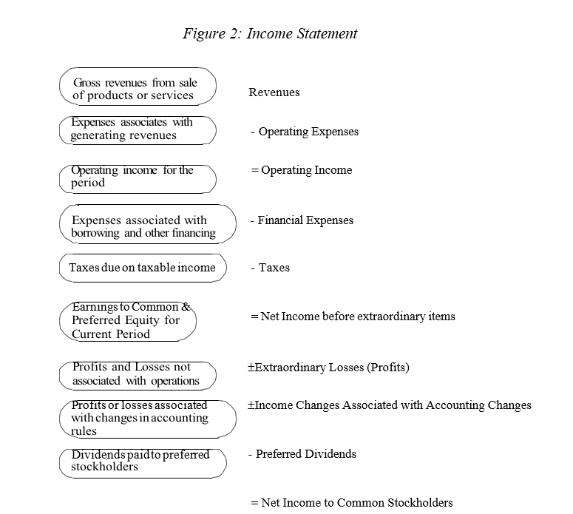
The Basic Accounting Statements
The next is the income statement, shown in Figure 2, which provides information on the revenues and expenses of the firm, and the resulting income made by the firm, during a period. The period can be a quarter (if it is a quarterly income statement) or a year (if it is an annual report).

Slide 20
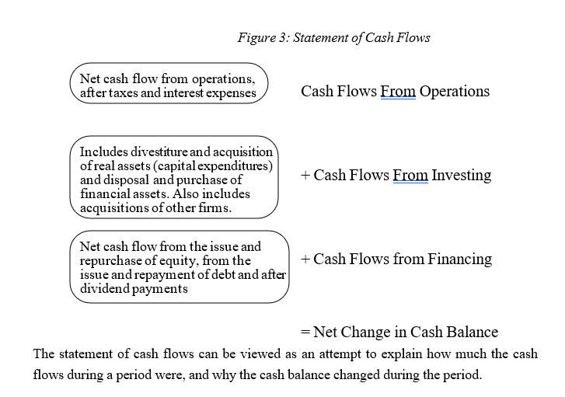
The Basic Accounting Statements
Finally, there is the statement of cash flows, shown in figure 3, which specifies the sources and uses of cash of the firm from operating, investing and financing activities, during a period.

Slide 21
What are Financial Ratios?
Financial ratios are created using numerical values taken from financial statements to gain meaningful information about a company. The numbers found on a company’s financial statements – balance sheet, income statement, and cash flow statement – are used to perform quantitative analysis and assess a company’s liquidity, leverage, growth, margins, profitability, rates of return, valuation, and more.
It is a comparative analysis between two factors.
Business performance can be measured by the use of ratios.

Slide 22
How a Ratio is expressed?
As Percentage - such as 25% or 50% . For example if net profit is Rs.25,000/- and the sales is Rs.1,00,000/- then the net profit can be said to be 25% of the sales.
As Proportion - The above figures may be expressed in terms of the relationship between net profit to sales as 1 : 4.
As Pure Number /Times - The same can also be expressed in an alternatively way such as the sale is 4 times of the net profit or profit is 1/4th of the sales.

Slide 23
Four Ways to Analyze Ratio
Four Ways to Analyze Ratio
Trend Analysis
It helps you analyze the movement of the variables compared.
Comparative Analysis
This helps to make comparisons of two companies of
Individual Analysis.
It helps you look into the persistent record of a particular.
Group Ratio Analysis
It helps the firm to determine the group of compared ratios of a across years.

Slide 24
Limitations of Ratio Analysis
It depends on the past data which in itself serves as a limiting factor.
It may not represent the correct picture of the business.
Only accounting information is used while analyzing and interpreting the results of ratio analysis.
In taking corrective actions, the management might concentrate more on improving the ratio over the years rather than solving the major reason behind such an adverse condition.

Slide 25
Some important notes
Liabilities have Credit balance, and Assets have a Debit balance
Current Liabilities are those which have either become due for payment or shall fall due for payment within 12 months from the date of Balance Sheet
Current Assets undergo a change in their shape/form within 12 months. These are also called Working Capital or Gross Working Capital
Net Worth & Long Term Liabilities are also called Long Term Sources of Funds
Current Liabilities are known as Short Term Sources of Funds
Long Term Liabilities & Short Term Liabilities are also called Outside Liabilities
Current Assets are Short Term Use of Funds

Slide 26
Some important notes
Assets other than Current Assets are Long Term Use Funds
Installments of a Term Loan Payable in 12 months are to be taken as Current Liabilities only for Calculating the Current Ratio and quick Ratio.
If there is profit, it shall become part of Net Worth under the head Reserves, and if there is loss, it will become part of Intangible Assets
Investments in Govt. Securities are to be treated currently only if they are marketable and due. Investments in other securities are to be treated as Current if they are quoted. Investments in allied/associate/sister units or firms are to be treated as Non-current.
Bonus Shares as issued by the capitalisation of General reserves and, as such, do not affect the Net Worth. With the Rights Issue, change takes place in Net Worth and Current Ratio.

Slide 27
Summary
We have covered the following topics in this lecture:
Introduction & Meaning of Ratio Analysis
Usefulness of Ratio Analysis
Limitations of Ratio Analysis
Classification of Ratios

Slide 28
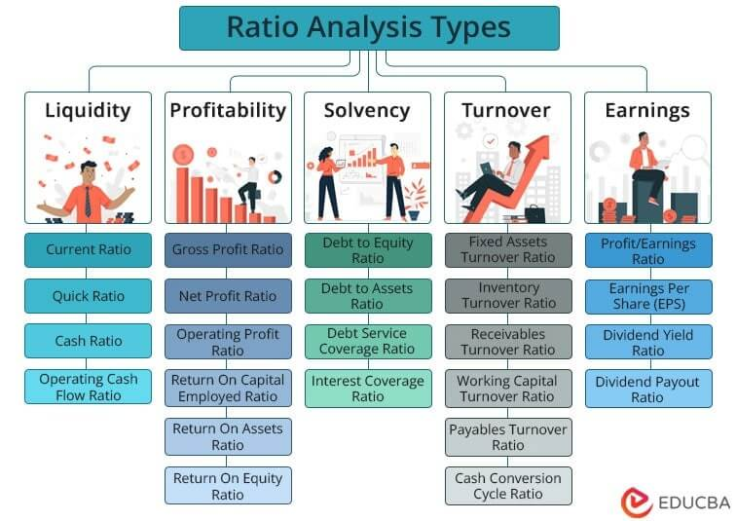

Financial Ratios

Slide 29
Liquidity Ratio
Liquidity is a very critical part of a business. Liquidity is required for a business to meet its short term obligations. Liquidity ratios are a measure of the ability of a company to pay off its short-term liabilities.
Liquidity ratios determine how quickly a company can convert the assets and use them for meeting the dues that arise. The higher the ratio, the easier is the ability to clear the debts and avoid defaulting on payments.
This is a very important criterion that creditors check before offering short term loans to the business. An organisation which is unable to clear dues results in creating impact on the creditworthiness and also affects credit rating of the company.
A liquidity ratio is a type of financial ratio used to determine a company’s ability to pay its short-term debt obligations. The metric helps determine if a company can use its current, or liquid, assets to cover its current liabilities.

Slide 30
Liquidity Ratio
Three liquidity ratios are commonly used – the current ratio, quick ratio, and cash ratio. In each of the liquidity ratios, the current liabilities amount is placed in the denominator of the equation, and the liquid assets amount is placed in the numerator.
Given the structure of the ratio, with assets on top and liabilities on the bottom, ratios above 1.0 are sought after. A ratio of 1 means that a company can exactly pay off all its current liabilities with its current assets. A ratio of less than 1 (e.g., 0.75) would imply that a company is not able to satisfy its current liabilities.
A ratio greater than 1 (e.g., 2.0) would imply that a company is able to satisfy its current bills. In fact, a ratio of 2.0 means that a company can cover its current liabilities two times over. A ratio of 3.0 would mean they could cover their current liabilities three times over, and so forth.

Slide 31
Types of Liquidity Ratios
1. Current Ratio
Current Ratio = Current Assets / Current Liabilities
The current ratio is the simplest liquidity ratio to calculate and interpret. Anyone can easily find the current assets and current liabilities line items on a company’s balance sheet. Divide current assets by current liabilities, and you will arrive at the current ratio.
2. Quick Ratio
Quick Ratio = (Cash + Accounts Receivables + Marketable Securities) / Current Liabilities
The quick ratio is a stricter test of liquidity than the current ratio. Both are similar in the sense that current assets is the numerator, and current liabilities is the denominator. However, the quick ratio only considers certain current assets. It considers more liquid assets such as cash, accounts receivables, and marketable securities. It leaves out current assets such as inventory and prepaid expenses because the two are less liquid. So, the quick ratio is more of a true test of a company’s ability to cover its short-term obligations.

Slide 32
Types of Liquidity Ratios
3. Cash Ratio
Cash Ratio = (Cash + Marketable Securities) / Current Liabilities
The cash ratio takes the test of liquidity even further. This ratio only considers a company’s most liquid assets – cash and marketable securities. They are the assets that are most readily available to a company to pay short-term obligations.
4. Net Working Capital Ratio
The net working capital ratio is used to determine whether a company has sufficient cash or funds to continue its operations. It is calculated by subtracting the current liabilities from the current assets.
Net Working Capital Ratio = Current Assets – Current Liabilities

Slide 33
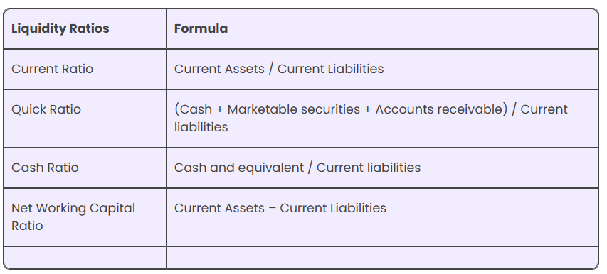
Types of Liquidity Ratios
Since the three ratios vary by what is used in the numerator of the equation, an acceptable ratio will differ between the three. It is logical because the cash ratio only considers cash and marketable securities in the numerator, whereas the current ratio considers all current assets. Therefore, an acceptable current ratio will be higher than an acceptable quick ratio. Both will be higher than an acceptable cash ratio.
For example, a company may have a current ratio of 3.9, a quick ratio of 1.9, and a cash ratio of 0.94. All three may be considered healthy by analysts and investors, depending on the company.

Slide 34
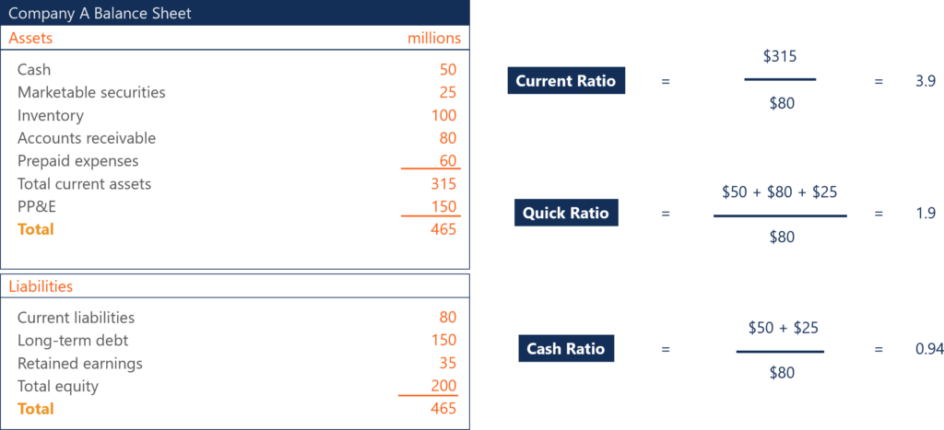
Types of Liquidity Ratios

Slide 35
Importance of Liquidity Ratios
1. Determine the ability to cover short-term obligations
Liquidity ratios are important to investors and creditors to determine if a company can cover their short-term obligations, and to what degree. A ratio of 1 is better than a ratio of less than 1, but it isn’t ideal.
Creditors and investors like to see higher liquidity ratios, such as 2 or 3. The higher the ratio is, the more likely a company is able to pay its short-term bills. A ratio of less than 1 means the company faces a negative working capital and can be experiencing a liquidity crisis.
2. Determine creditworthiness
Creditors analyze liquidity ratios when deciding whether or not they should extend credit to a company. They want to be sure that the company they lend to has the ability to pay them back. Any hint of financial instability may disqualify a company from obtaining loans.

Slide 36
Importance of Liquidity Ratios
3. Determine investment worthiness
For investors, they will analyze a company using liquidity ratios to ensure that a company is financially healthy and worthy of their investment. Working capital issues will put restraints on the rest of the business as well. A company needs to be able to pay its short-term bills with some leeway.
Low liquidity ratios raise a red flag, but “the higher, the better” is only true to a certain extent. At some point, investors will question why a company’s liquidity ratios are so high. Yes, a company with a liquidity ratio of 8.5 will be able to confidently pay its short-term bills, but investors may deem such a ratio excessive. An abnormally high ratio means the company holds a large amount of liquid assets.
For example, if a company’s cash ratio was 8.5, investors and analysts may consider that too high. The company holds too much cash on hand, which isn’t earning anything more than the interest the bank offers to hold their cash. It can be argued that the company should allocate the cash amount towards other initiatives and investments that can achieve a higher return.
With liquidity ratios, there is a balance between a company being able to safely cover its bills and improper capital allocation. Capital should be allocated in the best way to increase the value of the firm for shareholders.

Slide 37
Profitability Ratios
Profitability ratios measure a company’s ability to generate profit relative to its sales, assets, and equity.
Typically, a higher value indicates better financial health. But these ratios are just numbers when seen in isolation. They provide meaningful information when analyzed compared to an industry benchmark, the firm’s competitors, or its past performance.
Profitability ratio analysis helps answer essential questions, including:
Does a company produce value for shareholders?
How well does it utilize its assets to generate profit?
Does its financial performance improve or worsen over time?
How does it compare to its peers and industry benchmarks?
There’s no uniform formula for profitability ratios; it varies depending on the type of ratio we calculate. But for all types, we use information from the company’s Income Statement. So, before we move on to the definition, formulas, and types of probability ratios, let’s go over the Income Statement’s structure.

Slide 38
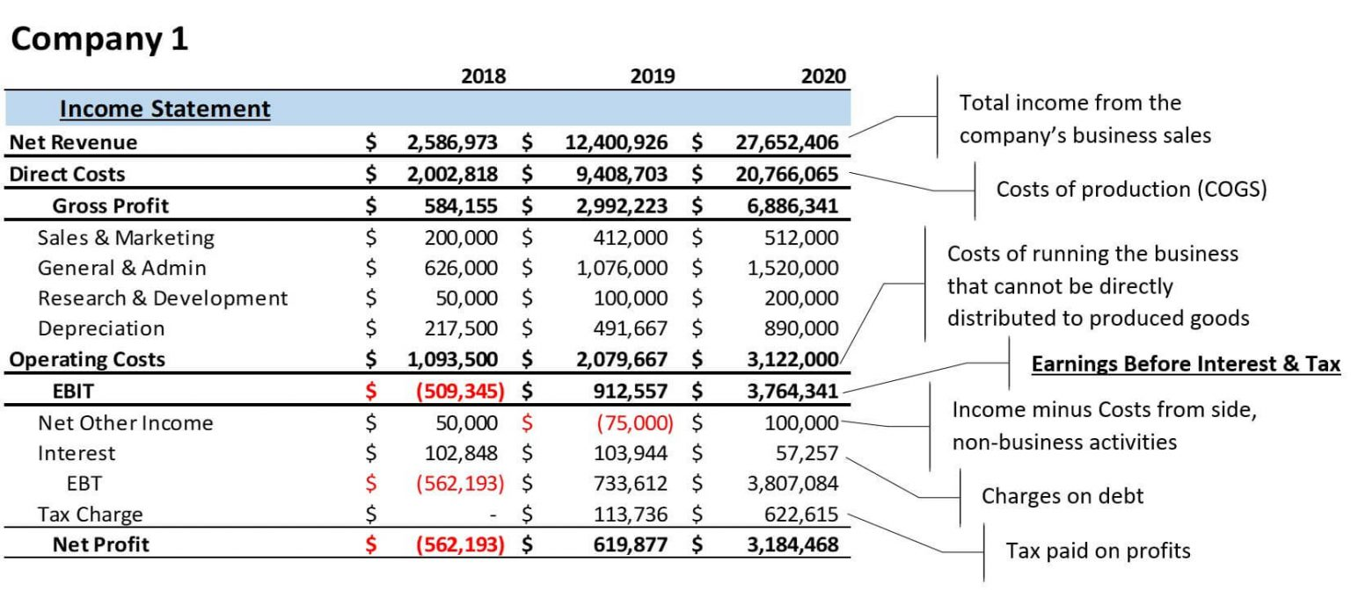
Income Statement Structure

Slide 39
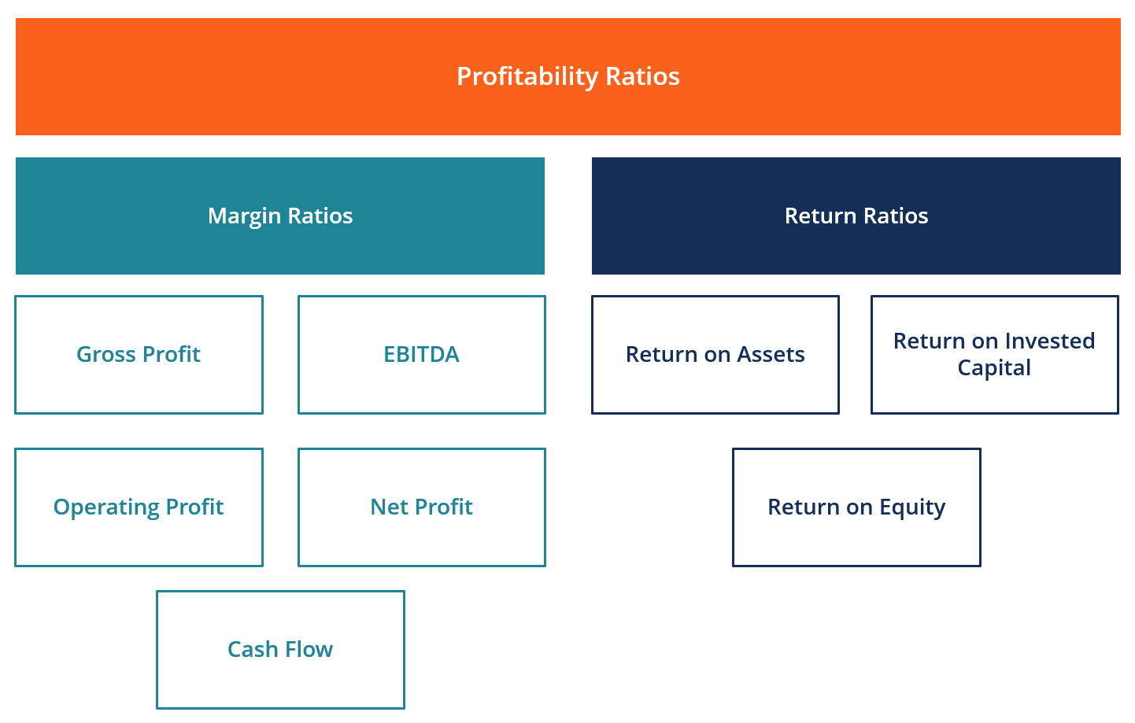
Profitability Ratios

Slide 40
Different Types of Profitability Ratios
A. Margin Ratios
Margin ratios represent the company’s ability to convert sales into profits at various degrees of measurement.
Examples are gross profit margin, operating profit margin, net profit margin, cash flow margin, EBIT, EBITDA, EBITDAR, NOPAT, operating expense ratio, and overhead ratio.
B. Return Ratios
Return ratios represent the company’s ability to generate returns to its shareholders.
Examples include return on assets, return on equity, cash return on assets, return on debt, return on retained earnings, return on revenue, risk-adjusted return, return on invested capital, and return on capital employed.

Slide 41

Net Profit Margin
Net Profit Margin (also known as “Profit Margin” or “Net Profit Margin Ratio”) is a financial ratio used to calculate the percentage of profit a company produces from its total revenue. It measures the amount of net profit a company obtains per dollar of revenue gained. The net profit margin is equal to net profit (also known as net income) divided by total revenue, expressed as a percentage.
The typical profit margin ratio of a company can be different depending on which industry the company is in. As a financial analyst, this is important in day-to-day financial analysis.

Slide 42
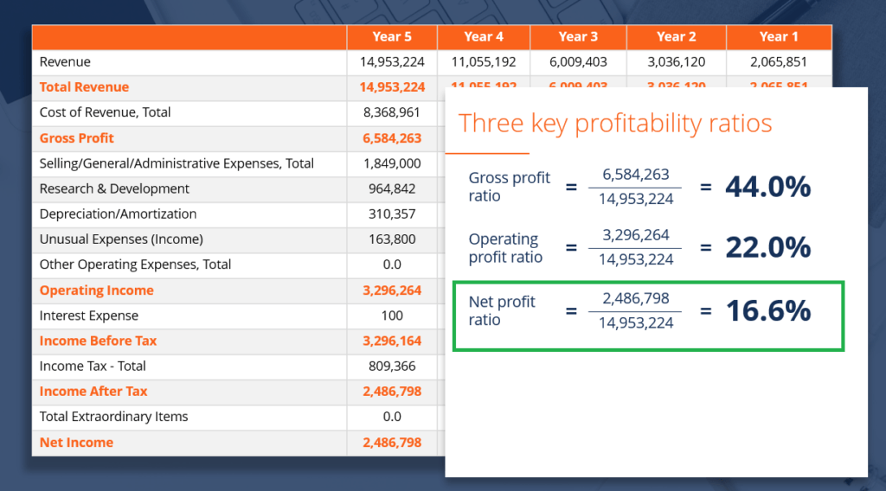
Net Profit Margin

Slide 43
Net Profit Margin Formula
Net Profit Margin = Net Profit ⁄ Total Revenue x 100
Net profit is calculated by deducting all company expenses from its total revenue. The profit margin calculation results in a percentage – for example, a 10% profit margin means for each $1 of revenue the company earns $0.10 in net profit. Revenue represents the total sales of the company in a period.
Calculation Example #1
Company XYZ and ABC both operate in the same industry. Which company has a higher net profit margin?

Slide 44
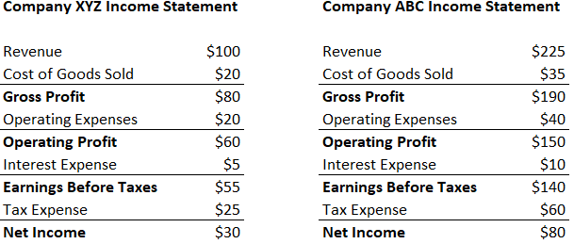
Example

Slide 45
Net Profit Margin Formula
Step 1: Write out the formula
Net Profit Margin = Net Profit/Revenue
Step 2: Calculate the net profit margin for each company
Company XYZ:
Net Profit Margin = Net Profit/Revenue = $30/$100 = 30%
Company ABC:
Net Profit Margin = Net Profit/Revenue = $80/$225 = 35.56%
Company ABC has a higher net profit margin.

Slide 46
Net Profit Margin Formula
Company A and Company B have net profit margi respectively. Both companies earned $150 in revenue. How much net profit did each company make?
Step 1: Write out the formula
Net Profit Margin = Net Profit/Revenue
Net Profit = Net Margin * Revenue
Step 2: Calculate net profit for each company
Company A:
Net Profit = Net Margin * Revenue = 12% * $150 = $18
Company B:
Net Profit = Net Margin * Revenue = 15% * $150 = $22.50

Slide 47
Net Profit Margin Understanding
The net profit margin ratio is used to describe a company’s ability to produce profit and to consider several scenarios, such as an increase in expenses which is deemed ineffective. It is used extensively in financial modeling and company valuation.
Net profit margin is a strong indicator of a firm’s overall success and is usually stated as a percentage. However, keep in mind that a single number in a company report is rarely adequate to point out overall company performance. An increase in revenue might translate to a loss if followed by an increase in expenses. On the other hand, a decrease in revenue, followed by tight control over expenses, might put the company further in profit.
Other common financial metrics are EBITDA and Gross Profit.

Slide 48
Net Profit Margin Understanding
A high net profit margin means that a company is able to effectively control its costs and/or provide goods or services at a price significantly higher than its costs. Therefore, a high ratio can result from:
Efficient management
Low costs (expenses)
Strong pricing strategies
A low net profit margin means that a company uses an ineffective cost structure and/or poor pricing strategies. Therefore, a low ratio can result from:
Inefficient management
High costs (expenses)
Weak pricing strategies

Slide 49
Limitations of Net Profit Margin Ratio
When calculating the net profit margin ratio, analysts commonly compare the figure to different companies to determine which business performs the best.
While this is common practice, the net profit margin ratio can greatly differ between companies in different industries. For example, companies in the automotive industry may report a high profit margin ratio but lower revenue as compared to a company in the food industry. A company in the food industry may show a lower profit margin ratio, but higher revenue.
It is recommended to compare only companies in the same sector with similar business models.
Other limitations include the possibility of misinterpreting the profit margin ratio and cash flow figures. A low net profit margin does not always indicate a poorly performing company. Also, a high net profit margin does not necessarily translate to high cash flows.

Slide 50
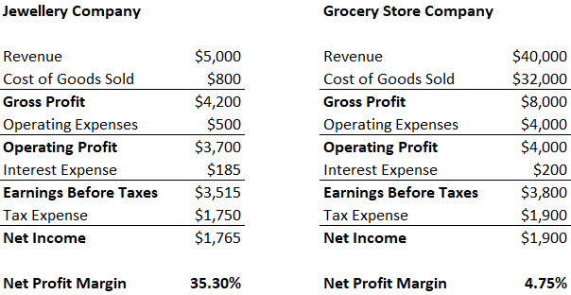
Limitations of Net Profit Margin Ratio
Limitations Example #1 – Comparing Companies
A jewelry company that sells a few expensive products may have a much higher profit margin as compared to a grocery store that sells many cheap products.

Slide 51
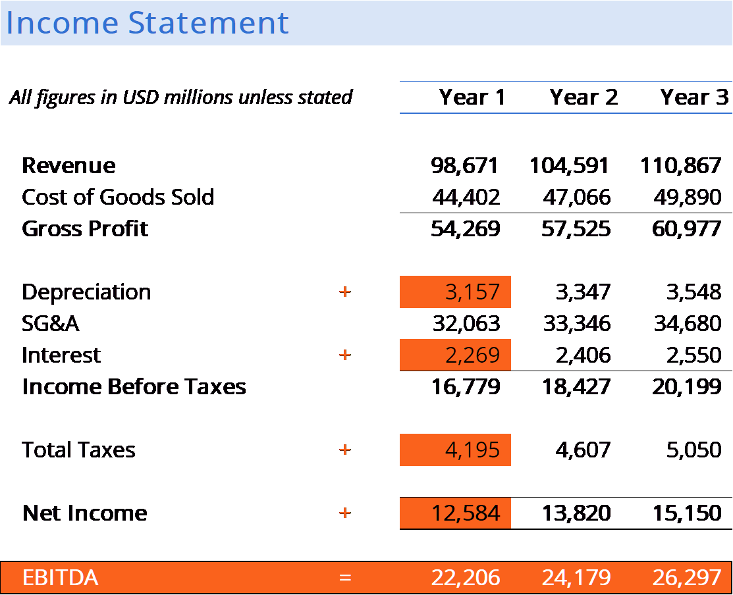
Profitability Ratios: EBITDA
EBITDA stands for Earnings Before Interest, Taxes, Depreciation, and Amortization and is a metric used to evaluate a company’s operating performance. It can be seen as a loose proxy for cash flow from the entire company’s operations.

Slide 52
Profitability Ratios: EBITDA
The EBITDA metric is a variation of operating income (EBIT) that excludes certain non-cash expenses. The purpose of these deductions is to remove the factors that business owners have discretion over, such as debt financing, capital structure, methods of depreciation, and taxes (to some extent). It can be used to showcase a firm’s financial performance without the impact of its capital structure.
EBITDA is not a recognized metric in use by IFRS or US GAAP. In fact, certain investors like Warren Buffet have a particular disdain for this metric, as it does not account for the depreciation of a company’s assets.
For example, if a company has a large amount of depreciable equipment (and thus a high amount of depreciation expense), then the cost of maintaining and sustaining these capital assets is not captured.

Slide 53
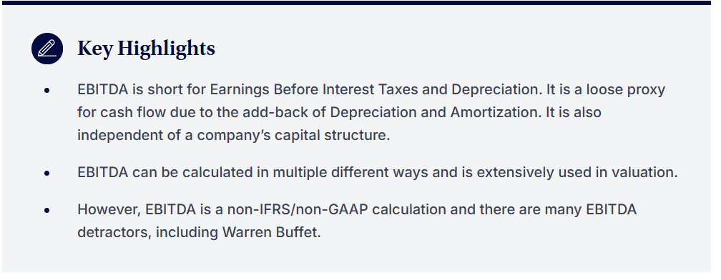
Profitability Ratios: EBITDA

Slide 54
Profitability Ratios: EBITDA
Here is the formula for calculating EBITDA:
EBITDA = Net Income + Interest + Taxes + Depreciation + Amortization
or
EBITDA = Operating Profit + Depreciation + Amortization

Slide 55
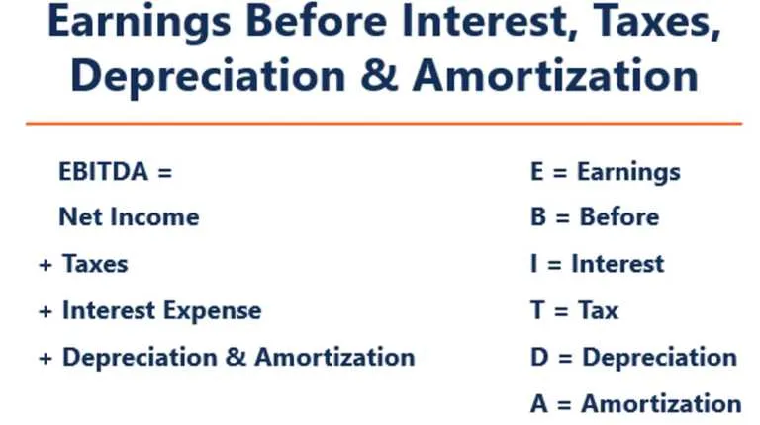
Profitability Ratios: EBITDA

Slide 56
Profitability Ratios: EBITDA
Interest
Interest expense is excluded from EBITDA, as this expense depends on the financing structure of a company. Interest expense comes from the money a company has borrowed to fund its business activities.
Different companies have different capital structures, resulting in different interest expenses. Hence, it is easier to compare the relative performance of companies by adding back interest and ignoring the impact of capital structure on the business. Note that interest payments are tax-deductible, meaning corporations can take advantage of this benefit in what is called a corporate tax shield.
Taxes
Taxes vary and depend on the region where the business is operating. They are a function of a jurisdiction’s tax rules, which are not really part of assessing a management team’s performance, and, thus, many financial analysts prefer to add them back when comparing businesses.

Slide 57
Profitability Ratios: EBITDA
Depreciation & Amortization
Depreciation and amortization (D&A) depend on the historical investments the company has made and not on the current operating performance of the business. Companies invest in long-term fixed assets (such as buildings or vehicles) that lose value due to wear and tear.
The depreciation expense is based on a portion of the company’s tangible fixed assets deteriorating over time. Amortization expense is incurred if the asset is intangible. Intangible assets such as patents are amortized because they have a limited useful life (competitive protection) before expiration.
D&A is heavily influenced by assumptions regarding useful economic life, salvage value, and the depreciation method used. Because of this, analysts may find that operating income is different than what they think the number should be, and therefore, D&A is backed out of the EBITDA calculation.
The D&A expense can be located in the firm’s cash flow statement under the cash from operating activities section. Since depreciation and amortization is a non-cash expense, it is added back (the expense is usually a positive number for this reason) while on the cash flow statement.

Slide 58
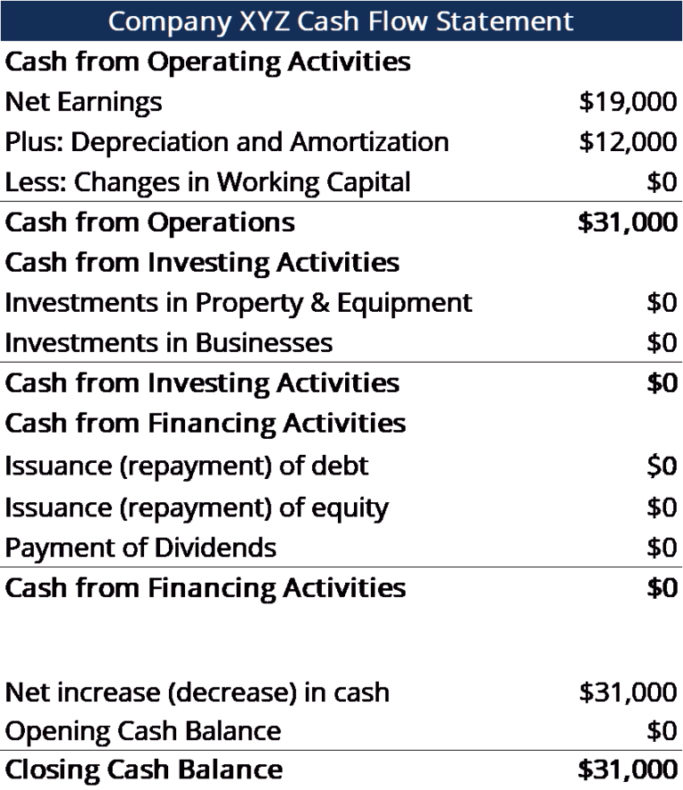
Profitability Ratios: EBITDA
Example: The depreciation and amortisation expense for XYZ is $12,000.

Slide 59
Profitability Ratios: EBITDA
Why Use EBITDA?
The EBITDA metric is commonly used as a loose proxy for cash flow. It can give an analyst a quick estimate of the value of the company, as well as a valuation range by multiplying it by a valuation multiple obtained from equity research reports, publicly traded peers, and industry transactions, or M&A.
In addition, when a company is not making a net profit, investors can turn to EBITDA to evaluate a company. Many private equity firms use this metric because it is very good for comparing similar companies in the same industry. Business owners use it to compare their performance against their competitors.
Disadvantages
EBITDA is not recognized by GAAP or IFRS. Some are skeptical (like Warren Buffett) of using it because it presents the company as if it has never paid any interest or taxes, and it shows assets as having never lost their natural value over time (no depreciation or capital expenditures are deducted).
For example, a fast-growing manufacturing company may present increasing sales and EBITDA year-over-year (YoY). To expand rapidly, it acquired many fixed assets over time and all were funded with debt. Although it may seem that the company has strong top-line growth, investors should look at other metrics as well, such as capital expenditures, cash flow, and net income.

Slide 60
EBITDA Used in Valuation (EV/EBITDA Multiple)
When comparing two companies, the Enterprise Value/EBITDA ratio can be used to give investors a general idea of whether a company is overvalued (high ratio) or undervalued (low ratio). It’s important to compare companies that are similar in nature (same industry, operations, customers, margins, growth rate, etc.), as different industries have vastly different average ratios (high ratios for high-growth industries, low ratios for low-growth industries).
The metric is widely used in business valuation and is found by dividing a company’s enterprise value by EBITDA.

Slide 61
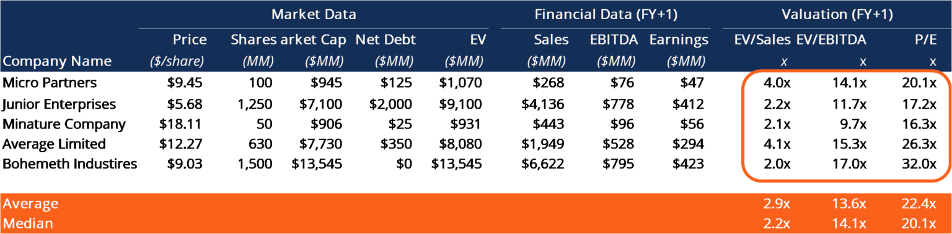
EBITDA Used in Valuation (EV/EBITDA Multiple)
EV/EBITDA Example:
Company ABC and Company XYZ are competing grocery stores that operate in New York. ABC has an enterprise value of $200M and an EBITDA of $10M, while firm XYZ has an enterprise value of $300M and an EBITDA of $30M. Which company is undervalued on an EV/EBITDA basis?

Slide 62
EBITDA Used in Valuation (EV/EBITDA Multiple)
Company ABC: Company XYZ:
EV = $200M EV = $300M
EBITDA = $10M EBITDA = $30M
EV/EBITDA = $200M/$10M = 20x EV/EBITDA = $300M/$30M = 10x
On an EV/EBITDA basis, company XYZ is undervalued because it has a lower ratio.

Slide 63
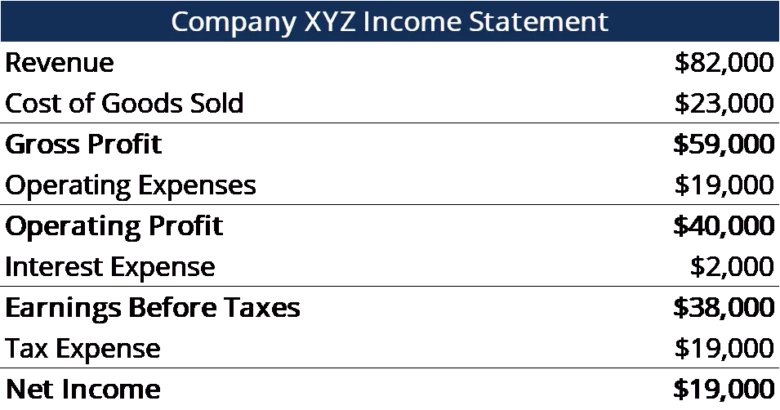
Profitability Ratios: EBITDA Example
Company XYZ accounts for their $12,000 depreciation and amortization expense as a part of their operating expenses. Calculate their Earnings Before Interest Taxes Depreciation and Amortization:

Slide 64
Profitability Ratios: EBITDA
EBITDA = Net Income + Tax Expense + Interest Expense + Depreciation & Amortization Expense
= $19,000 + $19,000 + $2,000 + $12,000
= $52,000
EBITDA = Revenue – Cost of Goods Sold – Operating Expenses + Depreciation & Amortization Expense
= $82,000 – $23,000 – $19,000 + $12,000
= $52,000

Slide 65
Profitability Ratios: EBITDA
Example Calculation #2
Company XYZ’s depreciation and amortization expense are incurred from using its machine that packages the candy the company sells. It pays 5% interest to debtholders and has a tax rate of 50%. What is XYZ’s Earnings Before Interest Taxes Depreciation and Amortization?

Slide 66
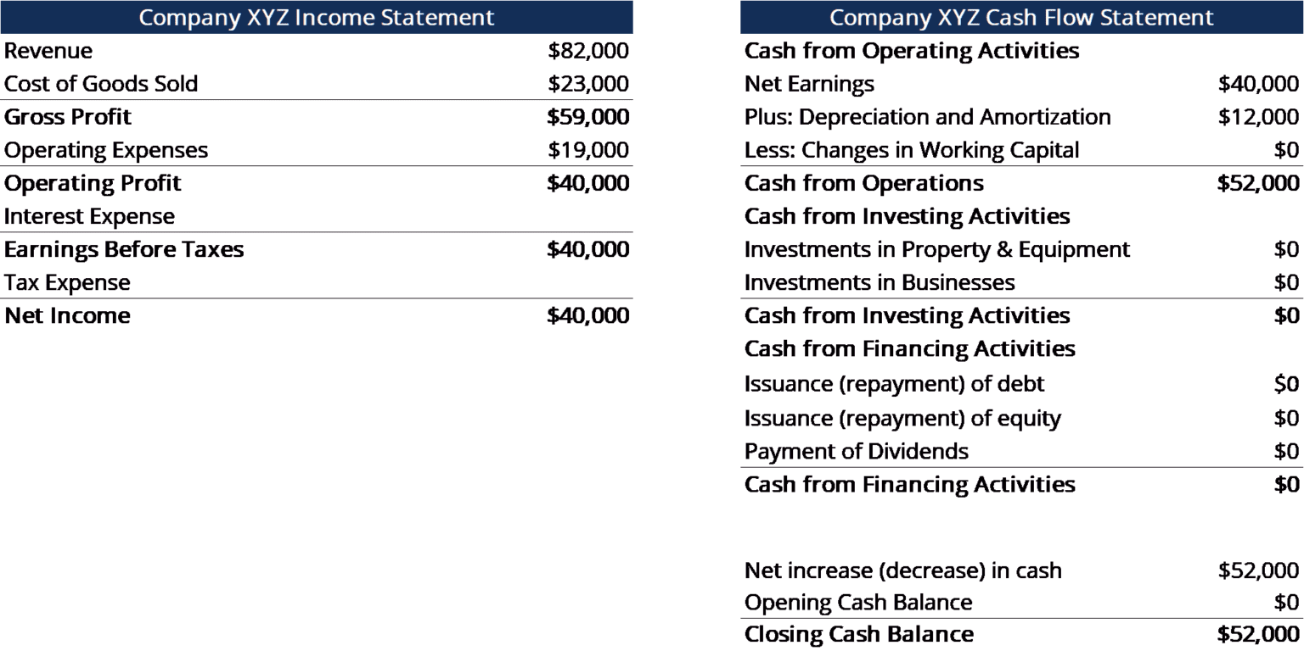
Profitability Ratios: EBITDA

Slide 67
Profitability Ratios: EBITDA
Interest expense = 5% * $40,000 (operating profit) = $2,000
Earnings Before Taxes = $40,000 (operating profit) – $2,000 (interest expense) = $38,000
Tax Expense = $38,000 (earnings before taxes) * 50% = $19,000
Net Income = $38,000 (earnings before taxes) – $19,000 (tax expense) = $19,000
Second Step: Find the depreciation and amortization expense
In the Statement of Cash Flows, the expense is listed as $12,000.
Since the expense is attributed to the machines that package the company’s candy (the depreciating asset directly helps with producing inventory), the expense will be a part of their cost of goods sold (COGS).
Third Step: Calculate Earnings Before Interest Taxes Depreciation and Amortization

Slide 68
Profitability Ratios: EBITDA
EBITDA = Net Income + Tax Expense + Interest Expense + Depreciation & Amortization Expense
= $19,000 + $19,000 + $2,000 + $12,000
= $52,000
EBITDA = Revenue – Cost of Goods Sold – Operating Expenses + Depreciation & Amortization Expense
= $82,000 – $23,000 – $19,000 + $12,000
= $52,000

Slide 69
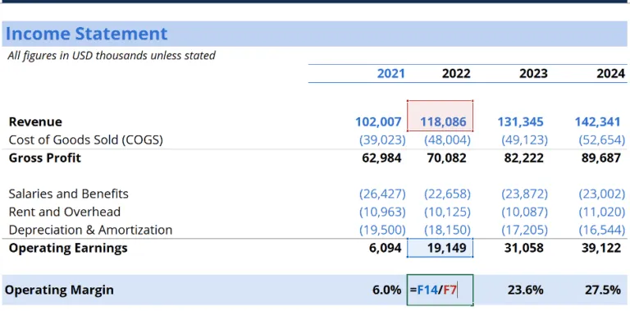
Profitability Ratios: Operating Margin (Return on Sales)
Operating margin, also known as return on sales, is an important profitability ratio measuring revenue after the deduction of operating expenses. It is calculated by dividing operating income by revenue. The operating margin indicates how much of the generated sales is left when all operating expenses are paid off.

Slide 70
Profitability Ratios: Operating Margin (Return on Sales)
In the above example, you can clearly see how to arrive at the 2022 operating margin for this company. 2022 has revenue of $118.1 million, less COGS of $48.0 million, resulting in gross profit of $70.1 million.
From there, another $22.7 million of salaries and benefits, $10.1 million of rent and overhead and $18.2 million of depreciation and amortization expenses are deducted, to arrive at operating income of $19.1 million.
By taking $19.1 million and dividing it by $118.1 million in revenue, we arrive at an operating margin of 16.2%, which is why operating margin is sometimes referred to as return on sales.

Slide 71
Profitability Ratios: Operating Margin (Return on Sales)
Key Highlights
Operating margin, also known as return on sales, is an important profitability ratio measuring revenue after covering the operating expenses of a business.
Operating margin is calculated by dividing operating income by revenue.
A business that can generate operating profit rather than a loss is a positive sign for potential investors and existing creditors. This means the company’s operating margin creates value for shareholders and continuous loan servicing for lenders.

Slide 72
Profitability Ratios: Operating Margin (Return on Sales)
Operating Margin Formula
Operating Margin = Operating Income / Revenue
Another example: DT Clinton Manufacturing company reported on $125 million in revenue in its 2022 annual income statement. Operating income before tax was $45 million after deducting $80 million in operating expenses for the year. As a result, the company has an operating margin of 36%. In other words, for every dollar in sales achieved, $0.36 cents is retained as operating profit.
Why is Profit Margin Important in Business?
A business that can generate operating profit rather than operating at a loss is a positive sign for potential investors and existing creditors. This means that the company’s operating margin creates value for shareholders and continuous loan servicing for lenders. The higher the margin a company has, all things being equal, the less financial risk it has. However, different industries will have different operating margins so any comparisons made should be relative to other, similar companies in the same industry. Continued increases in profit margin over time shows that profitability is improving. This may either be attributed to efficient control of operating costs or other factors that influence revenue, such as higher pricing, better marketing and increases in customer demand.

Slide 73
Profitability Ratios: Operating Margin (Return on Sales)
Operating Margin/Profit Drawbacks
Operating profit is an accounting metric and, therefore, not an indicator of economic value or cash flow. Profit includes several non-cash expenses such as depreciation and amortization, stock-based compensation, and other items. Conversely, it doesn’t include capital expenditures and changes in working capital.
In conjunction, these various items that are included or excluded can cause cash flow (the ultimate driver of value for a business) to be very different (higher or lower) than operating profit.

Slide 74
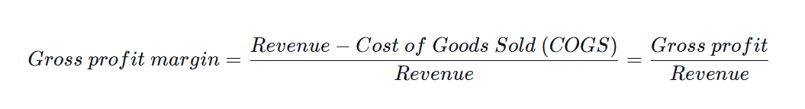
Profitability Ratios: Gross Profit Margin
The gross profit margin looks at the company’s profitability of production. It reveals whether a business sells its products at higher prices than their actual cost. The higher the gross margin, the more money there is to cover other expenses.
Note that direct costs (see the Income Statement) comprise the costs of the goods sold (COGS) and not the ones that have been produced and warehoused (the inventory).It’s rare to see negative margins at this level―if the produced items cost more than people are willing to pay, then the business is a non-starter.

Slide 75
Profitability Ratios: Cash Flow Margin
Expresses the relationship between cash flows from operating activities and sales generated by the business. It measures the ability of the company to convert sales into cash. The higher the percentage of cash flow, the more cash available from sales to pay for suppliers, dividends, utilities, and service debt, as well as to purchase capital assets. Negative cash flow, however, means that even if the business is generating sales or profits, it may still be losing money. In the instance of a company with inadequate cash flow, the company may opt to borrow funds or to raise money through investors in order to keep operations going.
Managing cash flow is critical to a company’s success because always having adequate cash flow both minimizes expenses (e.g., avoid late payment fees and extra interest expense) and enables a company to take advantage of any extra profit or growth opportunities that may arise (e.g. the opportunity to purchase at a substantial discount the inventory of a competitor who goes out of business).

Slide 76
Profitability Ratios: Cash Flow Margin
What is Operating Cash Flow?
Operating Cash Flow (OCF) is the amount of cash generated by the regular operating activities of a business within a specific time period.
The formula for each company will be a little different, but the basic structure always consists of the three same elements: 1) OCF begins with net income, 2) adds back any non-cash items, 3) and adjusts for changes in net working capital. Summing these three elements together arrives at the total cash generated or consumed by operations in the period.
When performing financial analysis, operating cash flow should be used in conjunction with net income, free cash flow (FCF), and other metrics to properly assess a company’s performance and financial health.

Slide 77
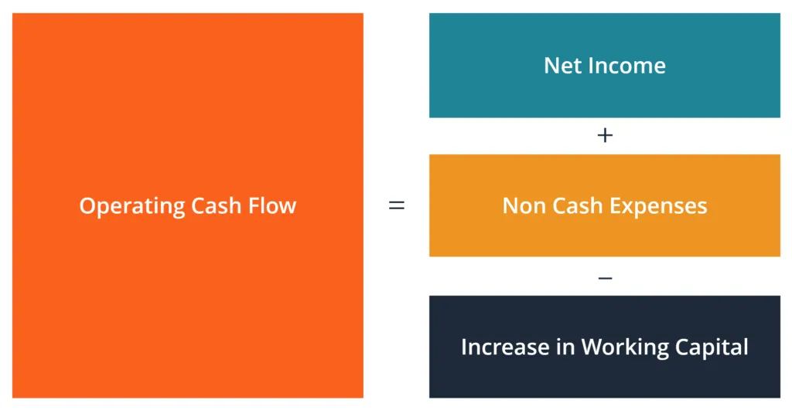
Profitability Ratios: Cash Flow Margin

Slide 78
Profitability Ratios: Cash Flow Margin
Key Highlights
Operating cash flow (OCF) is how much cash a company generated (or consumed) from its operating activities during a period.
The OCF calculation will always include the following three components: 1) net income, 2) plus non-cash expenses, and 3) minus the net increase in net working capital.
Financial analysts will look at OCF, along with free cash flow (FCF) and net income, to analyze a company’s profitability.

Slide 79
Profitability Ratios: Cash Flow Margin
Operating Cash Flow Example
Below is an example of operating cash flow (OCF) using Amazon’s 2022 annual report.
As you can see, the consolidated statement of cash flows is organized into three distinct sections, with operating activities at the top, then investing activities, and finally, financing activities. In addition to those three sections, the statement also shows the starting cash balance, total change for the period, and ending balance.
Let’s analyse how the operating section works:
Net income from the bottom of the income statement is used as the starting point
All non-cash items are “added back,” meaning any accruals are reversed, including:
Depreciation and amortization is the accrual-based expensing of capital the company invested in maintaining its property, equipment, website, software, etc.
Stock-based compensation is expensed but not paid out with actual cash; instead, this compensation is paid with the issuance of shares to key employees
Other expense/income could include various items such as unrealized gains or losses or other accrued items
Deferred taxes arise from the difference between accounting methods companies use when filing their taxes vs those needed for filing their financial statements

Slide 80
Profitability Ratios: Cash Flow Margin
Change in working capital (operating assets and liabilities) adjustments include:
When inventory on the balance sheet goes up, it results in a reduction of cash (or vice versa)
When accounts receivable increases, it also creates a reduction of cash, as it means a portion of the revenues recorded have not yet been paid by customers
When accounts payable, accrued expenses, and unearned revenue increase, they cause an increase in cash.

Slide 81
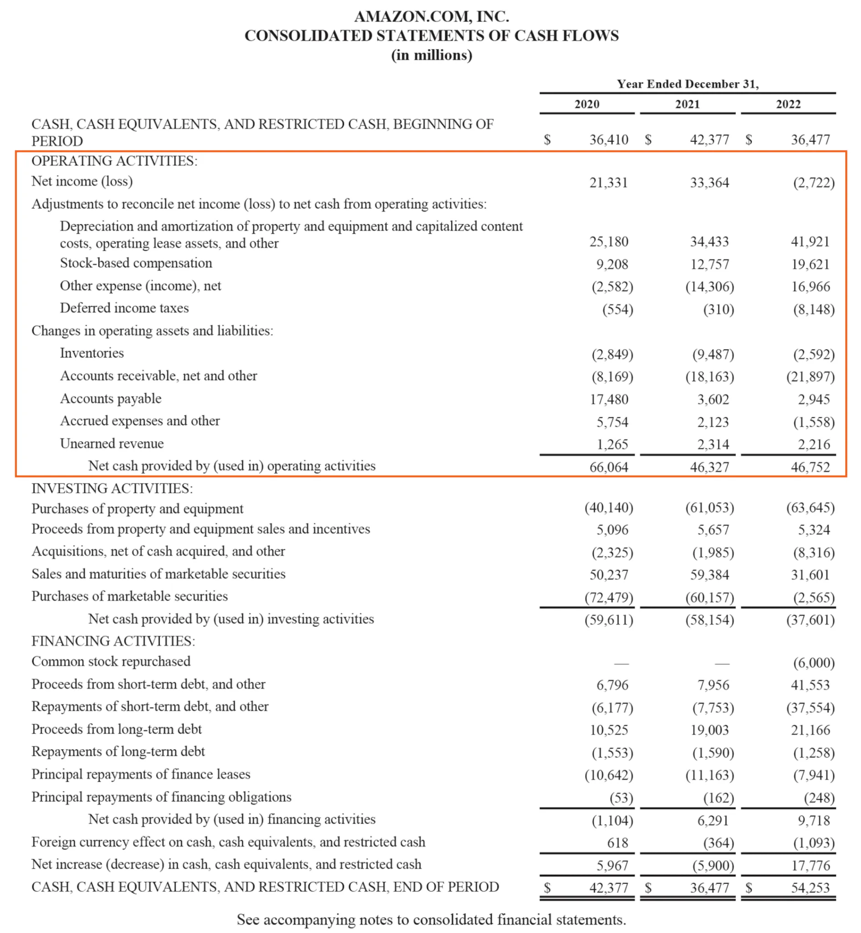
Profitability Ratios: Cash Flow Margin

Slide 82
Profitability Ratios: Cash Flow Margin

Slide 83
Profitability Ratios: Cash Flow Margin
Operating Cash Flow Formula
Whether you’re an accountant, a financial analyst, or a private investor, it’s important to know how to calculate how much cash flow was generated in a period. We sometimes take for granted when reading financial statements how many steps are actually involved in the calculation.
Let’s analyze the operating cash flow formula and each of the various components.
Formula (short form):
Operating Cash Flow = Net Income + Non-Cash Expenses – Increase in Working Capital

Slide 84
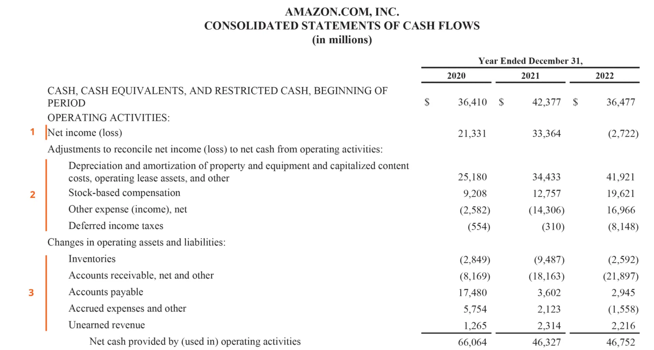
Profitability Ratios: Cash Flow Margin

Slide 85
Profitability Ratios: Cash Flow Margin
Using the short-form version of the operating cash flow formula, we can clearly see the three basic elements in every OCF calculation.
Net Income: Net income is the net after-tax profit of the business from the bottom of the income statement. It is the direct link between the income statement and the cash flow statement.
Non-cash Expenses: Non-cash expenses are all accrual-based expenses that are not actually paid for with cash or credit in a given period. The most common examples of non-cash expenses include depreciation and amortization, stock-based compensation, deferred tax, impairment charges, and unrealized gains or losses.
Non-cash Working Capital: Non-cash working capital is all current assets (except for cash) less all current liabilities (except for debt). An increase in current assets causes a reduction in cash, while an increase in current liabilities causes an increase in cash.

Slide 86
Profitability Ratios: Cash Flow Margin
Formula (long form):
Operating Cash Flow = Net Income + Depreciation & Amortization + Stock-Based Compensation + Deferred Tax + Other Non-Cash Items – Increase in Accounts Receivable – Increase in Inventory + Increase in Accounts Payable + Increase in Accrued Expenses + Increase in Deferred Revenue
The formulas above are meant to give you an idea of how to perform the calculation on your own; however, they are not entirely exhaustive.
There can be additional non-cash items and additional changes in current assets or current liabilities that are not listed above. The key is to ensure that all items are accounted for, and this will vary from company to company.

Slide 87
Profitability Ratios: Cash Flow Margin
Operating Cash Flow vs Net Income
Net income and earnings per share (EPS) are two of the most frequently referenced financial metrics, so how are they different from operating cash flow? The main difference comes down to accounting rules such as the matching principle and the accrual principle when preparing financial statements.
Net income includes various sorts of expenses, some that may have actually been paid for and some that may have simply been created by accounting principles (such as depreciation).
In addition, a company’s revenue recognition principle and matching of expenses to the timing of revenues can result in a material difference between OCF and net income.
Unfortunately, it is not possible to simply say that one number is always higher or lower than the other. Sometimes, OCF is higher than net income (as with Amazon), and sometimes it’s the opposite.

Slide 88
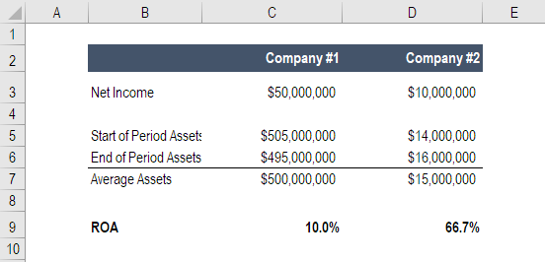
Profitability Ratios: Return on Assets & ROA
Return on Assets (ROA) is a type of return on investment (ROI) metric that measures the profitability of a business in relation to its total assets. This ratio indicates how well a company is performing by comparing the profit (net income) it’s generating to the capital it’s invested in assets. The higher the return, the more productive and efficient management is in utilizing economic resources.

Slide 89
Profitability Ratios: Return on Assets & ROA
What is the ROA Formula?
The ROA formula is:
ROA = Net Income / Average Assets
or
ROA = Net Income / End of Period Assets
Where:
Net Income is equal to net earnings or net income in the year (annual period)
Average Assets = (Starting Total Assets + Ending Total Assets) / 2

Slide 90
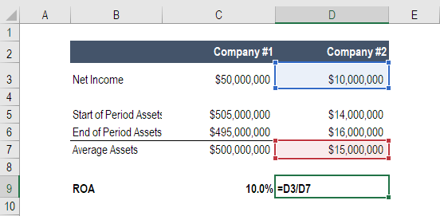
Profitability Ratios: Return on Assets & ROA

Slide 91
Profitability Ratios: Return on Assets & ROA
Example of ROA Calculation
Let’s walk through an example, step by step, of how to calculate return on assets using the formula above.
Q: If a business posts a net income of $10 million in current operations, and owns $50 million worth of assets as per the balance sheet, what is its return on assets?
A: $10 million divided by $50 million is 0.2, therefore the business’s ROA is 20%. For every dollar of assets the company invests in, it returns 20 cents in net profit per year.

Slide 92
Profitability Ratios: Return on Assets & ROA
What is the Importance of Return on Assets?
The ROA formula is an important ratio in analyzing a company’s profitability. The ratio is typically used when comparing a company’s performance between periods, or when comparing two different companies of similar size in the same industry. Note that it is very important to consider the scale of a business and the operations performed when comparing two different firms using ROA.
Typically, different industries have different ROA’s. Industries that are capital-intensive and require a high value of fixed assets for operations, will generally have a lower ROA, as their large asset base will increase the denominator of the formula. Naturally, a company with a large asset base can have a large ROA, if their income is high enough.

Slide 93
Profitability Ratios: Return on Assets & ROA
What is Net Income?
Net income is the net amount realized by a firm after deducting all the costs of doing business in a given period. It includes all interest paid on debt, income tax due to the government, and all operational and non-operational expenses.
Operational costs can include cost of goods sold (COGS), production overhead, administrative and marketing expenses, and amortization and depreciation of equipment and property.
Also added into net income is the additional income arising from investments or those that are not directly resulting from primary operations, such as proceeds from the sale of equipment or fixed assets. Note: non-operating items may be adjusted out of net income by a financial analyst.
Net income/loss is found at the bottom of the income statement and divided into total assets to arrive at ROA.

Slide 94
Profitability Ratios: Cash Flow Margin
Return on Assets for Companies
Below are some examples of the most common reasons companies perform an analysis of their return on assets.
1. Using ROA to determine profitability and efficiency
Return on assets indicates the amount of money earned per dollar of assets. Therefore, a higher return on assets value indicates that a business is more profitable and efficient.
2. Using ROA to compare performance between companies
It is important to note that return on assets should not be compared across industries. Companies in different industries vary significantly in their use of assets. For example, some industries may require expensive property, plant, and equipment (PP&E) to generate income as opposed to companies in other industries.

Slide 95
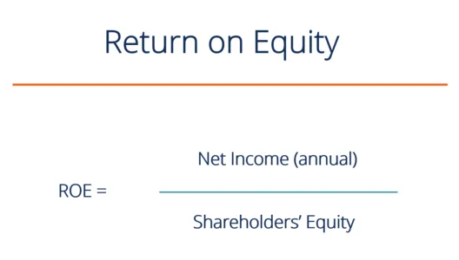
Profitability Ratios: Return on Equity (ROE)
Return on Equity (ROE) is the measure of a company’s annual return (net income) divided by the value of its total shareholders’ equity, expressed as a percentage (e.g., 12%). Alternatively, ROE can also be derived by dividing the firm’s dividend growth rate by its earnings retention rate (1 – dividend payout ratio).
Return on Equity is a two-part ratio in its derivation because it brings together the income statement and the balance sheet, where net income or profit is compared to the shareholders’ equity. The number represents the total return on equity capital and shows the firm’s ability to turn equity investments into profits. To put it another way, it measures the profits made for each dollar from shareholders’ equity.

Slide 96
Profitability Ratios: Return on Equity (ROE)
Return on Equity Formula
The following is the ROE equation:
ROE = Net Income / Shareholders’ Equity
ROE provides a simple metric for evaluating investment returns. By comparing a company’s ROE to the industry’s average, something may be pinpointed about the company’s competitive advantage. ROE may also provide insight into how the company management is using financing from equity to grow the business.
A sustainable and increasing ROE over time can mean a company is good at generating shareholder value because it knows how to reinvest its earnings wisely, so as to increase productivity and profits. In contrast, a declining ROE can mean that management is making poor decisions on reinvesting capital in unproductive assets.

Slide 97
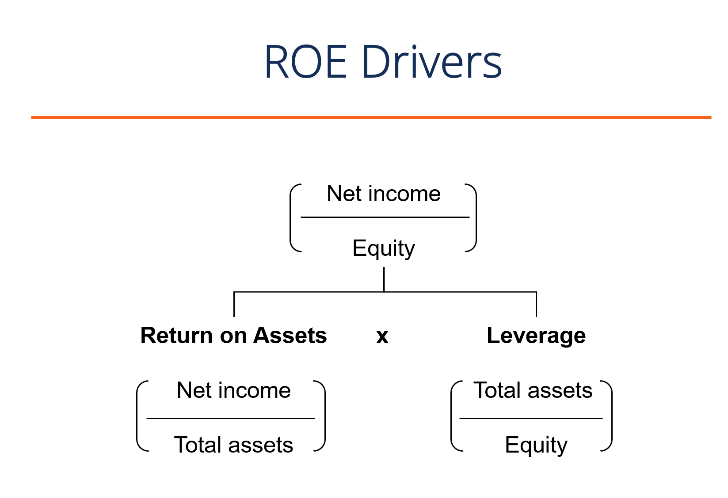
Profitability Ratios: Return on Equity (ROE)
ROE Formula Drivers
While the simple return on equity formula is net income divided by shareholder’s equity, we can break it down further into additional drivers. As you can see in the diagram below, the return on equity formula is also a function of a firm’s return on assets (ROA) and the amount of financial leverage it has. Both of these concepts will be discussed in more detail below.

Slide 98
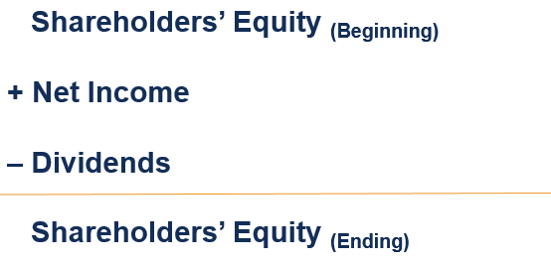
Profitability Ratios: Return on Equity (ROE)
Why is ROE Important?
With net income in the numerator, Return on Equity (ROE) looks at the firm’s bottom line to gauge overall profitability for the firm’s owners and investors. Stockholders are at the bottom of the pecking order of a firm’s capital structure, and the income returned to them is a useful measure that represents excess profits that remain after paying mandatory obligations and reinvesting in the business.

Slide 99
Profitability Ratios: Return on Equity (ROE)
Why Use the Return on Equity Metric?
Simply put, with ROE, investors can see if they’re getting a good return on their money, while a company can evaluate how efficiently they’re utilizing the firm’s equity. ROE must be compared to the historical ROE of the company and to the industry’s ROE average – it means little if merely looked at in isolation. Other financial ratios can be looked at to get a more complete and informed picture of the company for evaluation purposes.
Effect of Leverage
A high ROE could mean a company is more successful in generating profit internally. However, it doesn’t fully show the risk associated with that return. A company may rely heavily on debt to generate a higher net profit, thereby boosting the ROE higher.
As an example, if a company has $150,000 in equity and $850,000 in debt, then the total capital employed is $1,000,000. This is the same number of total assets employed. At 5%, it will cost $42,000 to service that debt, annually.
If the company manages to increase its profits before interest to a 12% return on capital employed (ROCE), the remaining profit after paying the interest is $78,000, which will increase equity by more than 50%, assuming the profit generated gets reinvested back. As we can see, the effect of debt is to magnify the return on equity.

Slide 100
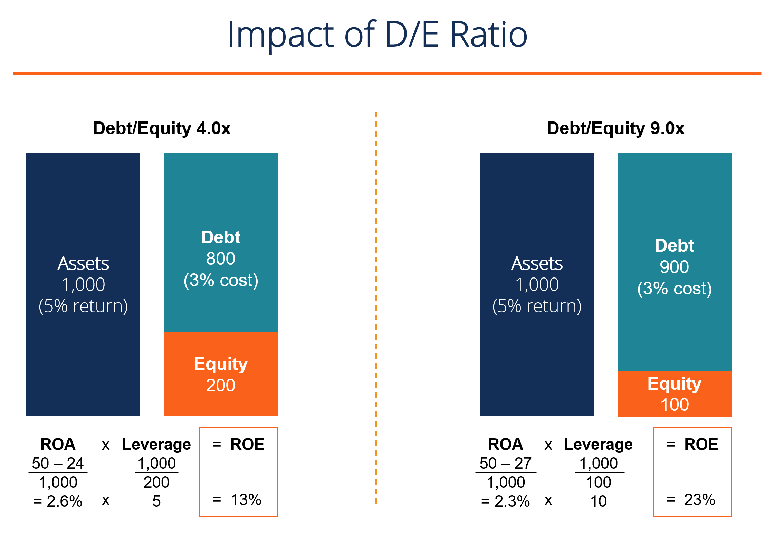
Profitability Ratios: Return on Equity (ROE)

Slide 101
Profitability Ratios: Return on Equity (ROE)
Drawbacks of ROE
The return on equity ratio can also be skewed by share buybacks. When management repurchases its shares from the marketplace, this reduces the number of outstanding shares. Thus, ROE increases as the denominator shrinks.
Another weakness is that some ROE ratios may exclude intangible assets from shareholders’ equity. Intangible assets are non-monetary items such as goodwill, trademarks, copyrights, and patents. This can make calculations misleading and difficult to compare to other firms that have chosen to include intangible assets.
Finally, the ratio includes some variations on its composition, and there may be some disagreements between analysts. For example, the shareholders’ equity can either be the beginning number, ending number, or the average of the two, while Net Income may be substituted for EBITDA and EBIT, and can be adjusted or not for non-recurring items.

Slide 102
Profitability Ratios: Return on Equity (ROE)
How to Use Return on Equity
Some industries tend to achieve higher ROEs than others, and therefore, ROE is most useful when comparing companies within the same industry. Cyclical industries tend to generate higher ROEs than defensive industries, which is due to the different risk characteristics attributable to them. A riskier firm will have a higher cost of capital and a higher cost of equity.
Furthermore, it is useful to compare a firm’s ROE to its cost of equity. A firm that has earned a return on equity higher than its cost of equity has added value. The stock of a firm with a 20% ROE will generally cost twice as much as one with a 10% ROE (all else being equal).

Slide 103

Profitability Ratios: Return on Equity (ROE)
The DuPont Formula
The DuPont formula breaks down ROE into three key components, all of which are helpful when thinking about a firm’s profitability. ROE is equal to the product of a firm’s net profit margin, asset turnover, and financial leverage:
DuPont Formula for Return on Equity
If the net profit margin increases over time, then the firm is managing its operating and financial expenses well and the ROE should also increase over time. If the asset turnover increases, the firm is utilizing its assets efficiently, generating more sales per dollar of assets owned.

Slide 104
Profitability Ratios: Return on Invested Capital (ROIC)
What is ROIC?
ROIC stands for Return on Invested Capital and is a profitability or performance ratio that aims to measure the percentage return that a company earns on invested capital. The ratio shows how efficiently a company is using the investors’ funds to generate income. Benchmarking companies use the ROIC ratio to compute the value of other companies.
ROIC Formula
Return on Invested Capital is calculated by taking into account the cost of the investment and the returns generated. Returns are all the earnings acquired after taxes but before interest is paid. The value of an investment is calculated by subtracting all current long-term liabilities, those due within the year, from the company’s assets.
The cost of investment can either be the total amount of assets a company requires to run its business or the amount of financing from creditors or shareholders. The return is then divided by the cost of investment.

Slide 105

Profitability Ratios: Return on Invested Capital (ROIC)

Slide 106
Profitability Ratios: Return on Invested Capital (ROIC)
Determining the Value of a Company
A company can evaluate its growth by looking at its return on invested capital ratio. Any firm earning excess returns on investments totaling more than the cost of acquiring the capital is a value creator and, therefore, usually trades at a premium. Excess returns may be reinvested, thus securing future growth for the company. An investment whose returns are equal to or less than the cost of capital is a value destroyer.
Generally speaking, a company is considered to be a value creator if its ROIC is at least two percent more than the cost of capital; a value destroyer is typically defined as any company whose ROIC is two percent less than its cost of capital. There are some companies that run at zero returns, whose return percentage on the value of capital lies within the set estimation error, which in this case is 2%.

Slide 107
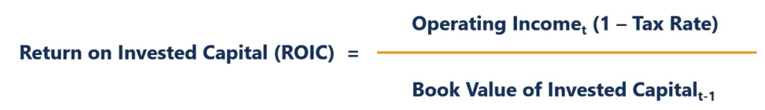
Profitability Ratios: Return on Invested Capital (ROIC)
Calculating the ROIC for a Company
A company’s return on invested capital can be calculated by using the following formula:
The book value is considered more appropriate to use for this calculation than the market value. The return on capital invested calculated using market value for a rapidly growing company may result in a misleading number. The reason for this is that market value tends to incorporate future expectations.
Also, the market value gives the value of existing assets to reflect the business’ earning power. In a case where there are no growth assets, the market value may mean that the return on capital equals the cost of capital.
To get the invested capital for firms with minority holdings in companies that are viewed as non-operating assets, the fixed assets are added to the working capital. Alternatively, for a company with long-term liabilities that are not regarded as a debt, add the fixed assets and the current assets and subtract current liabilities and cash to calculate the book value of invested capital.
The return on invested capital should reflect the total returns earned on the capital invested in all of the projects listed on the company’s books, with that amount compared to the company’s cost of capital.

Slide 108


Profitability Ratios: Return on Invested Capital (ROIC)
Determining a Company’s Competitiveness
A business is defined as competitive if it earns a higher profit than its competitors. A company becomes competitive mainly when its production cost per unit is lower than that of its competitors.
Competitive advantages can be analyzed from either a production or consumption viewpoint. A company has a production advantage when it can supply goods and services at a lower price than competitors are able to match. It has an advantage from a consumption perspective when it can supply goods or services difficult for other competitors to imitate. The ROIC ratio helps to determine the length or durability of a firm’s competitive advantages. Following is an alternative formula for calculating the ROIC:

Slide 109
Solvency Ratio
A solvency ratio is a performance metric that helps us examine a company’s financial health. In particular, it enables us to determine whether the company can meet its financial obligations in the long term.
The metric is very useful to lenders, potential investors, suppliers, and any other entity that would like to do business with a particular company. It usually compares the entity’s profitability with its obligations to determine whether it is financially sound. In that regard, a higher or strong solvency ratio is preferred, as it is an indicator of financial strength. On the other hand, a low ratio exposes potential financial hurdles in the future.

Slide 110
Solvency Ratio
How to Calculate the Solvency Ratio
As explained later, there are a couple of other ways to determine a company’s solvency, but the main formula for calculating the solvency ratio is as follows:
Solvency Ratio = (Net Income + Depreciation) / All Liabilities (Short-term + Long-term Liabilities)
If you examine it keenly, you will notice that the numerator comprises the entity’s current cash flow, while the denominator is made up of its liabilities. Thus, it is safe to conclude that the solvency ratio determines whether a company’s cash flow is adequate to pay its total liabilities.

Slide 111
Solvency Ratio
Example of Solvency Ratio
Let us consider a company X which has closed the FY 2022-2023 with the below annual financial data –
Net Income: Rs. 1,850 crores
Depreciation: Rs. 235.7 crores
Short-term debt: Rs. 991 crores
Long-term debt: Rs. 1,123.5 crores
Solvency Ratio = (Short-term Debt + Long-term Debt) / Equity
Given the financial data, first, we need to calculate the company’s equity. You can calculate equity using the below formula:
Equity = Net Income + Depreciation
Equity = Rs. 1,850 crores + Rs. 235.7 crores = Rs. 2,085.7 crores

Slide 112
Solvency Ratio
Now, we can calculate the solvency ratio:
Solvency Ratio = (Short-term Debt + Long-term Debt) / Equity
Solvency Ratio = (Rs. 991 crores + Rs. 1,123.5 crores) / Rs. 2,085.7 crores
Solvency Ratio ≈ 1.05
In this example, the solvency ratio is approximately 1.05. This means that for every Rs. 1 of equity, the company has Rs. 1.05 of debt (both short-term and long-term combined). A solvency ratio above 1 indicates that the company has more debt than equity, which suggests a higher degree of financial risk.

Slide 113
Solvency Ratio
How to Interpret the Solvency Ratio?
When interpreting the solvency ratio, it’s important to consider industry benchmarks and the company’s specific circumstances. A higher ratio may indicate a higher level of financial leverage, which can be acceptable or risky depending on the industry and the company’s ability to service its debt obligations.
Here’s a detailed interpretation of the solvency ratio:
Solvency Ratio Less Than 1: The solvency ratio of less than 1 indicates that the company’s total debt exceeds its equity. In these circumstances, the company may be technically insolvent, meaning it doesn’t have enough assets to cover its obligations. The solvency ratio of less than 1 is a red flag suggesting financial distress or bankruptcy.
Solvency Ratio Equal to 1: A solvency ratio of 1 means that the company’s total debt equals its total equity. While this technically implies a balance between debt and equity, it doesn’t indicate the business’s financial health is excellent. It is a borderline situation, and the company might struggle to cover its debt obligations.

Slide 114
Solvency Ratio
Solvency Ratio Greater Than 1: A solvency ratio above 1 suggests that the company has more equity than debt. This is generally a positive sign. It indicates that the company has the financial resources to cover its debt obligations. A solvency ratio above 1.5 indicates good financial health because it provides a comfortable buffer to meet obligations.
Solvency Ratio Significantly Greater Than 1: A significant solvency ratio above 1 may indicate that the company has good equity and a higher growth potential or returns value to shareholders through dividends or share buybacks.

Slide 115
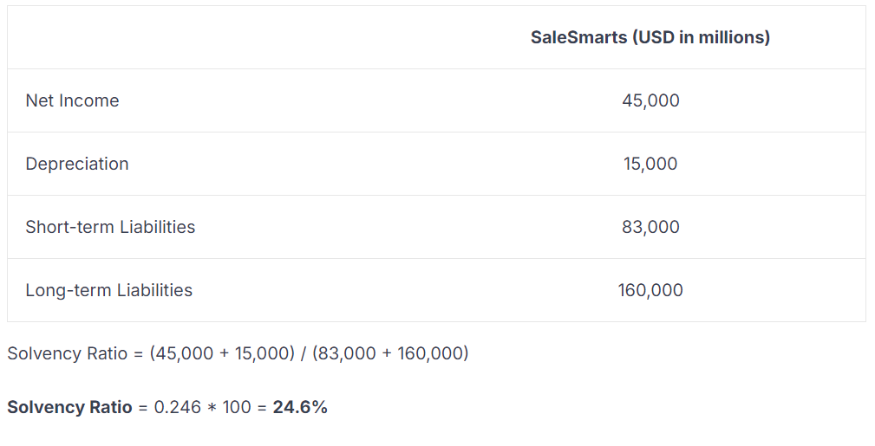
Solvency Ratio: Practical Example

Slide 116
Solvency Ratio
Important to note is that a company is considered financially strong if it achieves a solvency ratio exceeding 20%. So, from our example above, it is clear that if SalesSmarts keeps up with the trend each year, it can repay all its debts within four years (100% / 24.6% = Approximately four years).
Limitation of the Solvency Ratio
Although the solvency ratio is a useful measure, there is one area where it falls short. It does not factor in a company’s ability to acquire new funding sources in the long term, such as funds from stock or bonds. For such a reason, it should be used alongside other types of analysis to provide a comprehensive overview of a business’s solvency.

Slide 117
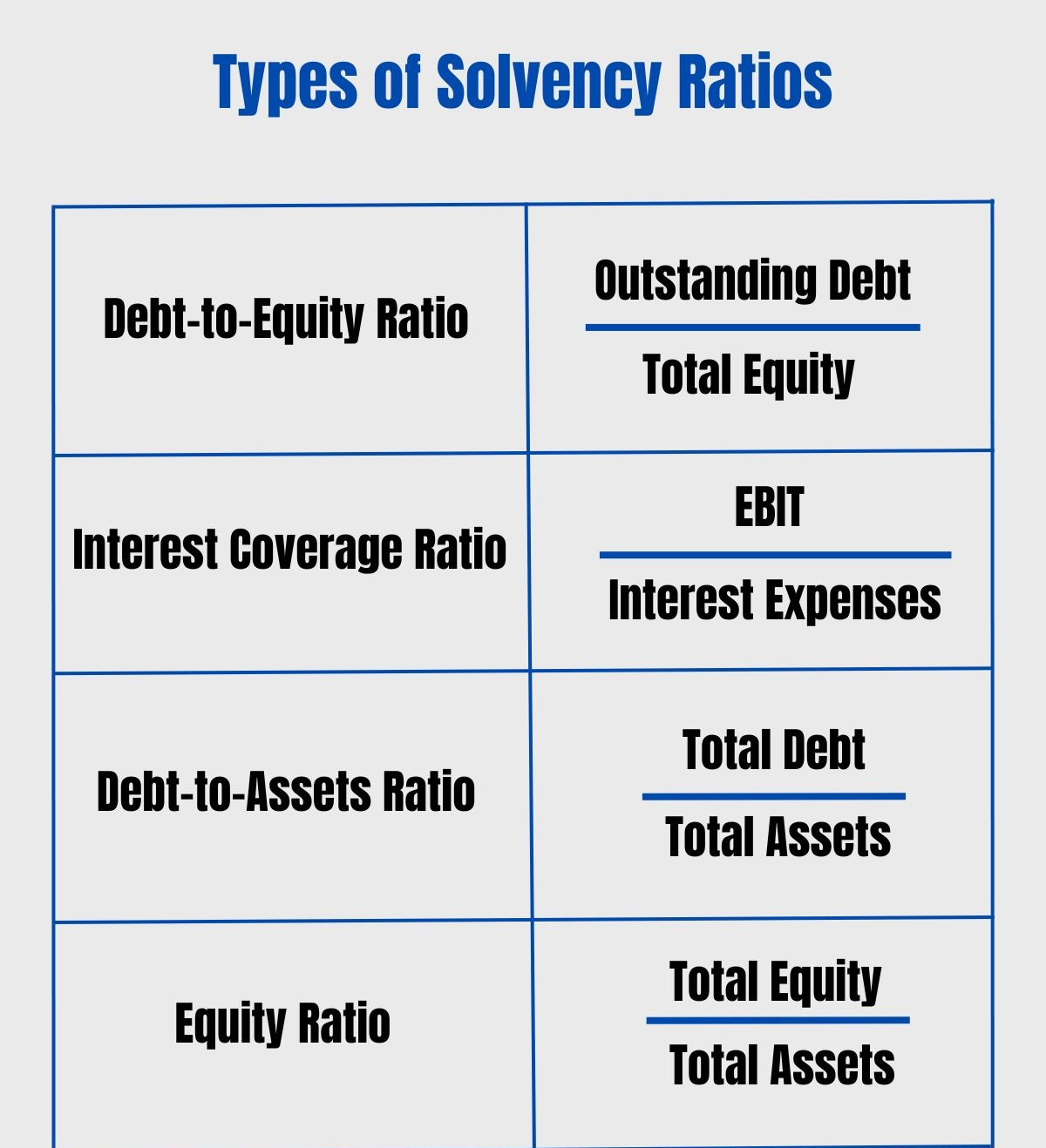
Solvency Ratio

Slide 118
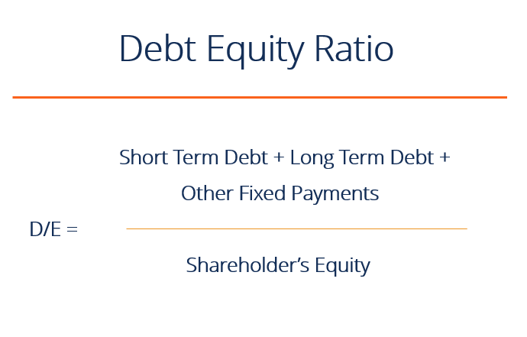
Solvency Ratio : Debt Equity Ratio
The Debt to Equity ratio (also called the “debt-equity ratio”, “risk ratio”, or “gearing”), is a leverage ratio that calculates the weight of total debt and financial liabilities against total shareholders’ equity. Unlike the debt-assets ratio which uses total assets as a denominator, the D/E Ratio uses total equity. This ratio highlights how a company’s capital structure is tilted either toward debt or equity financing.

Slide 119
Solvency Ratio : Debt Equity Ratio
Debt to Equity Ratio Formula
Short formula:
Debt to Equity Ratio = Total Debt / Shareholders’ Equity
Long formula:
Debt to Equity Ratio = (short term debt + long term debt + fixed payment obligations) / Shareholders’ Equity

Slide 120
Solvency Ratio : Debt Equity Ratio
Debt to Equity Ratio in Practice
If, as per the balance sheet, the total debt of a business is worth $50 million and the total equity is worth $120 million, then debt-to-equity is 0.42. This means that for every dollar in equity, the firm has 42 cents in leverage. A ratio of 1 would imply that creditors and investors are on equal footing in the company’s assets.
A higher debt-equity ratio indicates a levered firm, which is quite preferable for a company that is stable with significant cash flow generation, but not preferable when a company is in decline. Conversely, a lower ratio indicates a firm less levered and closer to being fully equity financed. The appropriate debt to equity ratio varies by industry.

Slide 121
Solvency Ratio : Debt Equity Ratio
What is Total Debt?
A company’s total debt is the sum of short-term debt, long-term debt, and other fixed payment obligations (such as capital leases) of a business that are incurred while under normal operating cycles. Creating a debt schedule helps split out liabilities by specific pieces.
Not all current and non-current liabilities are considered debt. Below are some examples of things that are and are not considered debt.
Benefits of a High D/E Ratio
A high debt-equity ratio can be good because it shows that a firm can easily service its debt obligations (through cash flow) and is using the leverage to increase equity returns.
In the example below, we see how using more debt (increasing the debt-equity ratio) increases the company’s return on equity (ROE). By using debt instead of equity, the equity account is smaller and therefore, return on equity is higher.

Slide 122
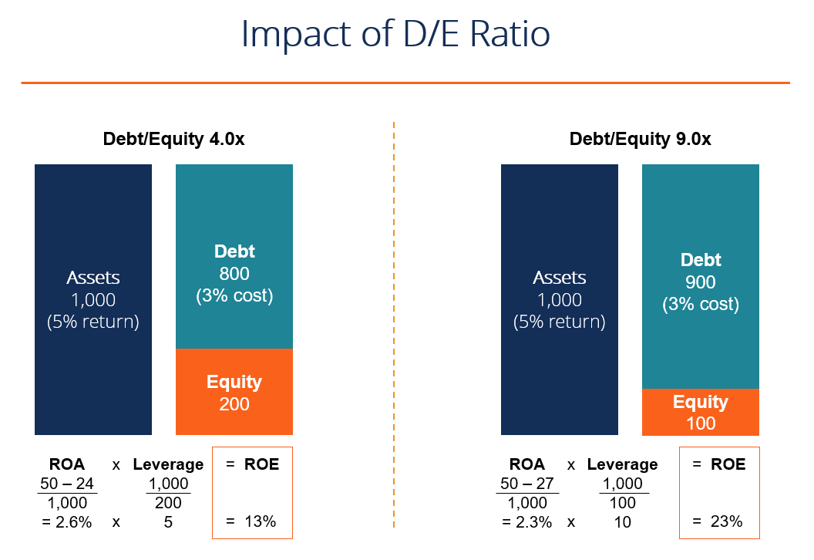
Solvency Ratio : Debt Equity Ratio

Slide 123
Solvency Ratio : Debt Equity Ratio
Drawbacks of a High D/E Ratio
The opposite of the above example applies if a company has a D/E ratio that’s too high. In this case, any losses will be compounded down and the company may not be able to service its debt.
If the debt to equity ratio gets too high, the cost of borrowing will skyrocket, as will the cost of equity, and the company’s WACC will get extremely high, driving down its share price.

Slide 124
Solvency Ratio : Debt Equity Ratio
Example –
To calculate the Debt-to-Equity (D/E) Ratio, let’s take the example of a fictional company, Company A. Here’s the financial data for Company A, where –
Total debt: Rs. 2,500,000
Total equity: Rs. 5,000,000
Using the provided data:
=> Rs. 2,500,000 /Rs. 5,000,000 = 0.5
So, the Debt-to-Equity Ratio for Company A is 0.5.
Interpretation: A Debt-to-Equity Ratio of 0.5 indicates that Company A has ₹0.5 in debt for every ₹1 in equity. This ratio suggests that the company has a moderate level of debt relative to its equity, and its financial position can be considered balanced. It’s neither excessively leveraged nor highly equity-funded.

Slide 125
Solvency Ratio : Interest Coverage Ratio
Interest coverage ratio is one of the most important ratios that need to be learned when assessing risk management and the possible reduction methods. Interest coverage ratio plays a very important role for stockholders and investors as it measures the ability of a business to pay interests on its outstanding debt.
It acts as a solvency check for the business organisation using which financial advisors, business analysts and investors can determine the ability of a business or a company to pay off the accumulated interest on the debt they are holding.
Interest coverage ratio is also known as debt service coverage ratio or debt service ratio. It is determined by dividing the earnings before interest and taxes (EBIT) with the interest expenses payable by the company during the same period.
In other words, the interest coverage ratio measures the number of times a company is able to make payments on its existing debt with the EBIT or earnings before interest and taxes. It is also known as the Times Interest Earned Ratio or TIE ratio.

Slide 126
Solvency Ratio : Interest Coverage Ratio
Determining this ratio helps the lenders, investors, stockholders and debenture holders with the data on how efficiently the business or the company is able to make payment for interest due on the long term borrowings of the business.
An interest coverage ratio of 1.5 is considered as healthy for a business. In general, a higher interest coverage ratio means that a company is earning sufficient money in order to pay off the interests due on long term loans, which indicates that there is a very less chance of a financial default.
Similarly, a low interest coverage ratio indicates a higher debt burden on the company which increases the chances of bankruptcy. In such cases banks would hesitate to provide credit to the business.

Slide 127
Solvency Ratio : Interest Coverage Ratio
Calculating Interest Coverage Ratio
The interest coverage ratio can be represented by the following formula
Interest Coverage Ratio = EBIT / Interest Expenses
Where EBIT = Earnings before interest and taxes
Interest Expenses = Interest payable on long term borrowings
Let us understand the concept of interest coverage ratio with a solved example.

Slide 128
Solvency Ratio : Interest Coverage Ratio
Question:-- Unreal Inc. has the following details from their accounting records
Sales Revenue = 500,000
COGS = 120,000
Operating expenses in the form of
Salary – 50,000
Rent – 40,000
Utilities – 20,000
Interest Expense – 30,000
Find the interest coverage ratio from the above provided information.

Slide 129
Solvency Ratio : Interest Coverage Ratio
Answer:
We know that,
EBIT = Total Revenue – COGS – Operating Expenses
Therefore,
Operating expense = 50,000 + 40,000 +20,000
= 1,10,000
Now,
EBIT = 500,000 – 120,000 – 110,000
= 2,70,000
Therefore,
Interest Coverage Ratio = EBIT / Interest Expenses
= 2,70,000 / 30,000
= 9

Slide 130
Turnover Ratios
What is the Turnover Ratio?
The turnover ratio can be defined as the ratio to calculate the quantity of any asset which is used by a business to generate revenue through its sales. It is the relation between the amount of a company’s assets and the revenue generated from them. To be more precise, it is an efficiency ratio to check how efficiently the company uses different assets to extract earnings from them (individually and as a whole). A higher ratio is considered to be better as it would indicate that the company is optimally using the resources to earn revenue. It would imply a higher ROI, and the funds invested are used the least.
What Is Turnover Ratios Formula?
Turnover ratios measure how efficiently the facilities, including the assets and liabilities of the organization, are utilized. The turnover ratios formula includes inventory turnover ratio, receivables turnover ratio, capital employed turnover ratio, working capital turnover ratio, asset turnover ratio, and accounts payable turnover ratio.

Slide 131
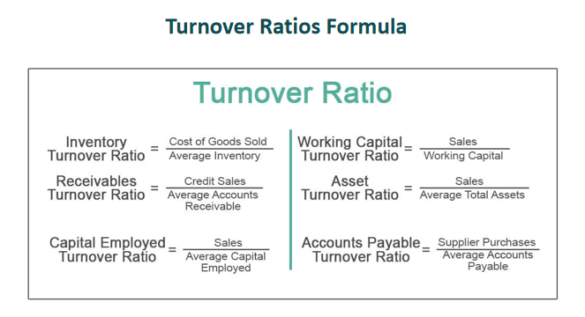
Turnover Ratios

Slide 132
Turnover Ratios
How To Calculate?
Let us understand the different turnover ratio calculation formula and how to calculate them in details.
#1 - Inventory Turnover Ratio:
In order to calculate the inventory turnover ratio, we should undertake the following steps:
Step 1: We need to calculate the cost of goods sold. The cost of goods sold is computed by adding the beginning inventory to the purchases made during the period and subtracting the ending inventory for the period.
Cost of Goods Sold = Beginning Inventory + Purchases During the Period – Ending Inventory.
Step 2: The average inventory should be calculated by using the formula mentioned below:
Average Inventory = Opening Inventory + Closing Inventory/2
Step 3: The inventory turnover ratio is required to be calculated. The result can be obtained by using the formula mentioned below:
Inventory Turnover Ratio = Cost of Goods Sold / Average Inventory

Slide 133
Turnover Ratios
#2 - Receivables Turnover Ratio
In order to calculate the receivables turnover ratio, we should systematically follow the steps mentioned below:
Step 1: Calculate the total credit sales. Credit Sales are the purchases made by the customers for which payment is given on a later date and is hence delayed.
Step 2: We should compute the average accounts receivable by using the formula:
Average Accounts Receivable = Opening Accounts Receivable + Closing Accounts Receivable /2
Step 3: Calculate the receivables turnover ratio calculation formula by using the formula mentioned below:
Receivables Turnover Ratio = Credit Sales / Average Accounts Receivable

Slide 134
Turnover Ratios
#3 - Capital Employed Turnover Ratio
To calculate the above ratio, the steps are as given below:
Step 1: Calculate the total sales
Step 2: Compute the average capital employed by using the formula mentioned below:
Average Capital Employed = Opening Capital Employed+Closing Capital Employed/2
Step 3: Calculate the capital employed turnover ratio by using the formula mentioned below:
Capital Employed Turnover Ratio = Sales / Average Capital Employed

Slide 135
Turnover Ratios
#4 - Working Capital Turnover Ratio
In order to calculate the working capital turnover ratio, the following steps are required to be followed:
Step 1: Calculate the total sales. This refers to the total amount of sales conducted by a firm in a given period of time.
Step 2: Calculate the working capital by using the formula mentioned below:
Working Capital = Current Assets – Current Liabilities
Step 3: Compute the working capital turnover ratio by using the working capital turnover ratio formula mentioned below:
Working Capital Turnover Ratio = Sales / Working Capital

Slide 136
Turnover Ratios
#5 - Asset Turnover Ratio
In order to calculate the asset turnover ratio, we should follow the following steps:
Step 1: Find out the sales
Step 2: Calculate the average total assets by using the formula mentioned below:
Average Total Assets = Opening Total Assets + Closing Total Assets / 2
Step 3: Calculate the asset turnover ratio. The formula can be computed as follows:
Asset Turnover Ratio = Sales / Average Total Assets

Slide 137
Turnover Ratios
#6 - Accounts Payable Turnover Ratio
In order to calculate the accounts payable turnover ratio, carry out the following steps:
Step 1: Find out the Supplier Purchases
Step 2: Calculate the average accounts payable. For this purpose, the following formula should be used
Average Accounts Payable = Opening Accounts Payable + Closing Accounts Payable /2
Step 3: In this step, the accounts payable turnover ratio should be calculated by using the formula:
Accounts Payable Turnover Ratio = Supplier Purchases / Average Accounts Payable

Slide 138
Turnover Ratios
Example #1
Georgia Inc. gives you the following information. From the above information, you are required to calculate the Inventory Turnover Ratio and Asset Turnover Ratio.
Cost of Goods Sold: 50000
Average Inventory: 5000
Sales: 100000
Average Total Assets: 20000
Solution
Calculation of Inventory Turnover Ratio
Turnover Formula Example 1.1

Slide 139
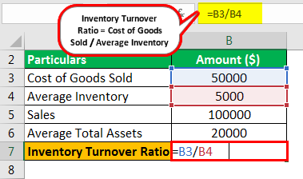
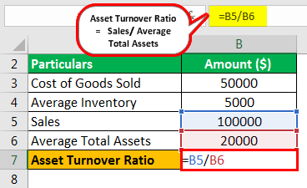
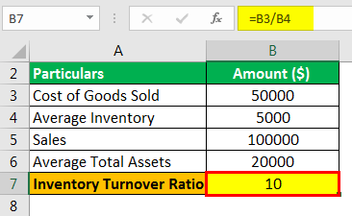
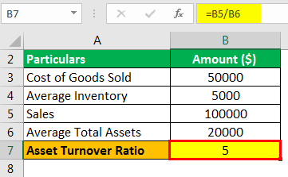
Turnover Ratios
Calculation of Asset Turnover Ratio
Inventory Turnover Ratio will be -
Asset Turnover Ratio will be -

Slide 140
Turnover Ratios
For Students to solve Example #2
Credence Inc. gives the following information about its business. Calculate the following a)Capital Employed Turnover Ratio. b) Working Capital Turnover Ratio.
Sales: 40000
Average Capital Employed: 20000
Current Assets: 30000
Current Liabilities: 10000

Slide 141
Turnover Ratios
Accounts receivable turnover ratio: How to calculate accounts receivable turnover ratio and speed up your collections
1. What is accounts receivable turnover ratio and why is it important for your business?
One of the key indicators of how well your business is managing its cash flow and credit policies is the accounts receivable turnover ratio. This ratio measures how efficiently your business collects payments from its customers who buy on credit. In this section, we will explain what is accounts receivable turnover ratio, how to calculate it, and why it is important for your business. We will also provide some tips on how to improve your accounts receivable turnover ratio and speed up your collections.
- What is accounts receivable turnover ratio? Accounts receivable turnover ratio is a financial ratio that shows how many times your business can collect its average accounts receivable during a given period. It is calculated by dividing the net credit sales by the average accounts receivable. Net credit sales are the total sales made on credit minus any returns or allowances. Average accounts receivable are the sum of the accounts receivable at the beginning and the end of the period divided by two.

Slide 142
Turnover Ratios
- How to calculate accounts receivable turnover ratio? To calculate accounts receivable turnover ratio, you need to have the following information: net credit sales and average accounts receivable. You can find these numbers in your income statement and balance sheet, respectively. The formula for accounts receivable turnover ratio is:
$$\text{Accounts receivable turnover ratio} = \frac{\text{Net credit sales}}{\text{Average accounts receivable}}$$
For example, suppose your business had net credit sales of $500,000 and average accounts receivable of $50,000 in the last year. Your accounts receivable turnover ratio would be:
$$\text{Accounts receivable turnover ratio} = \frac{500,000}{50,000} = 10$$
This means that your business collected its average accounts receivable 10 times in the last year.

Slide 143
Turnover Ratios
- Why is accounts receivable turnover ratio important for your business? Accounts receivable turnover ratio is important for your business because it reflects how well you are managing your cash flow and credit policies. A high accounts receivable turnover ratio means that your business is collecting payments from its customers quickly and efficiently. This improves your cash flow and reduces the risk of bad debts. A low accounts receivable turnover ratio means that your business is collecting payments from its customers slowly and inefficiently. This reduces your cash flow and increases the risk of bad debts. A low accounts receivable turnover ratio can also indicate that your business is offering too generous credit terms to its customers or that your customers are having financial difficulties.

Slide 144
Turnover Ratios
- How to improve your accounts receivable turnover ratio and speed up your collections? There are several ways to improve your accounts receivable turnover ratio and speed up your collections. Some of them are:
1. Review your credit policies and terms. You should have clear and consistent credit policies and terms for your customers. You should also check the creditworthiness of your customers before extending credit to them. You can use credit reports, references, and other sources to assess their financial situation and payment history. You should also set reasonable credit limits and payment deadlines for your customers.
2. Invoice your customers promptly and accurately. You should send your invoices to your customers as soon as possible after the sale or service is completed. You should also make sure that your invoices are accurate and detailed. You should include the date, amount, description, and terms of the sale or service. You should also include your contact information and payment methods. You should also follow up with your customers to confirm that they have received your invoices and that they have no questions or disputes.
3. Remind your customers of their due payments. You should send friendly and timely reminders to your customers of their due payments. You can use phone calls, emails, letters, or text messages to communicate with your customers. You should also keep a record of your communication and follow-up actions. You should also offer incentives or discounts for early or prompt payments and penalties or fees for late or missed payments.

Slide 145
Market Value Ratios/ Earning Ratios
What are market value ratios?
Market value ratios are financial metrics used by investors to evaluate and compare stocks. Market value ratios relate the market price of a stock to some measure of the company’s financial performance, such as earnings, cash flow, book value, or sales. Market value ratios help investors assess the valuation of a stock – whether it is undervalued, overvalued, or fairly priced compared to peers. Common market value ratios include the price-to-earnings ratio (P/E), price-to-book ratio (P/B), and price-to-sales ratio (P/S).
For example, a stock trading at a P/E of 15 means investors are willing to pay Rs. 15 for every Rs. 1 of earnings per share. This P/E is compared to the company’s historical average, competitors’ P/E, or the overall market average to judge if it is under or overvalued. Market value ratios are widely used by investors for stock analysis and valuation as they provide a normalized way to compare the relative valuation of stocks across sectors and industries.

Slide 146
Market Value Ratios/ Earning Ratios
Why are market value ratios important?
Market value ratios like price-to-earnings and price-to-book value are important analytical tools for investors in the stock market as they provide insight into the relative valuation and financial health of companies.
The most basic use of market value ratios is to determine if a stock is undervalued, overvalued, or fairly valued. For instance, all other things being equal, Stock A probably has a more appealing value if it trades at a P/E of 10x while Stock B trades at 25x. Market value ratios provide a normalized comparison of valuation across different stocks. Without these ratios, comparing valuations would be much more difficult.
By comparing a stock’s current market value ratio to its historical average, investors see if the stock is trading above or below its normal valuation range. For instance, a company is sometimes undervalued if it has historically traded at an average P/B of 2x but is currently trading at 1.5x. Looking at historical market value ratios provides useful context for determining cheap versus expensive levels.
Market value ratios also enable comparison versus industry peers. A tech stock is sometimes overpriced in comparison to peers if its direct competitors trade at a lower P/S ratio than it does, with the tech stock having an 8x P/S ratio. Comparing ratios to those of peers is key for relative valuation analysis.

Slide 147
Market Value Ratios/ Earning Ratios
Certain sectors tend to have higher multiples than others based on growth, margins, and other factors. Market value ratios make it possible to consistently compare stocks across different industries. For example, consumer staples stocks will trade at a much lower P/E than high-growth tech stocks. The ratios control for this sector variance in multiples.
Ratios like P/E are also calculated for the overall stock market to derive market multiples. Comparing a stock’s ratio to the broad market average ratio provides perspective on relative valuation – a stock with a P/E of 20x when the market P/E is 15x seems overvalued versus market peers.
Trends in market value ratios over time provide clues into overall investor sentiment for a stock. For example, a rising P/B multiple sometimes indicates increasing investor confidence and optimism about the company’s growth prospects and future returns on equity. Falling ratios could signal concerns surrounding downside risks.
Valuation ratios feed into pricing models to help estimate both upside potential and downside risk. A higher possible stock price upside is indicated if the valuation means reverts or if ratios indicate undervaluation. High ratios suggest elevated valuation risk on the downside. The ratios help gauge the reasonableness of price targets.
Scanning for stocks with attractive market value ratios is a common technique investors use to generate investing ideas. For example, screening for stocks with low P/E and P/B ratios is a classic way investors look for potential value stocks. The ratios serve as useful screens to identify stocks for further research.

Slide 148
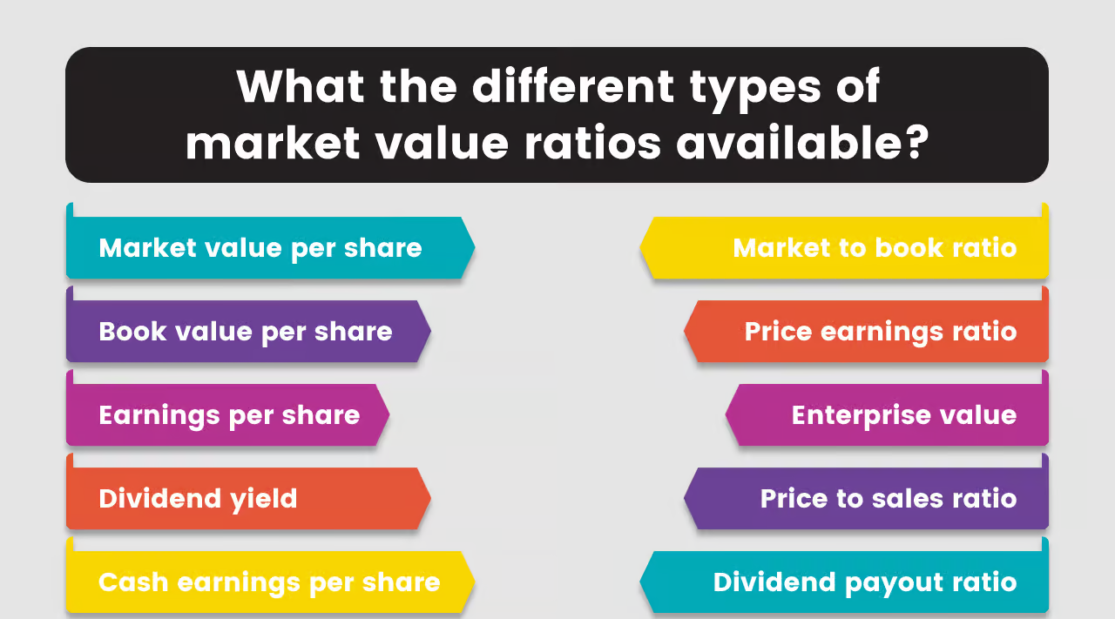
Market Value Ratios/ Earning Ratios
What are the different types of market value ratios available?

Slide 149
Market Value Ratios/ Earning Ratios
1.Market value per share
The market value per share is the current market price of a single share of a company’s stock. It represents the market’s valuation of the company on a per-share basis. The market value per share changes constantly during trading hours as the stock price fluctuates. It is calculated by taking the current market price and dividing it by the total number of outstanding shares.
The market Value per Share Formula is as stated below.
Market Value per Share = Current Market Price per Share / Number of Outstanding Shares
For example, let’s say a company has 100,000 outstanding shares, and the current market price per share is Rs. 50. To calculate the market value per share, we take the current market price of Rs. 50 and divide it by the total number of outstanding shares, which is 100,000.
Market Value per Share = Rs. 50 / 100,000
= Rs. 0.50
So, the market value per share in this example is Rs. 0.50. This means the total market capitalization of the company is Rs. 50,000 (100,000 shares x Rs. 0.50 per share). The market value per share is a measure of what the stock market believes the company as a whole is worth on a per-share basis at any given time when shares are actively trding. It fluctuates throughout the trading day as the market price changes.

Slide 150
Market Value Ratios/ Earning Ratios
2. Book value per share
The book value per share is the value of a company’s assets minus its liabilities, divided by the number of outstanding shares. It represents the theoretical value per share if the company was liquidated and paid off all its liabilities. Unlike market value, book value is based on a company’s balance sheet and not the current market price of its stock.
The book Value per Share Formula is as stated below.
Book Value per Share = (Total Assets – Total Liabilities) / Number of Outstanding Shares
For example, let’s say a company has total assets of Rs. 100 million and total liabilities of Rs. 20 million. The company also has 50,000 outstanding shares.
Book Value per Share = (Rs. 100 million – Rs. 20 million) / 50,000
= Rs. 80 million / 50,000
= Rs. 1.60
So, the book value per share in this example is Rs. 1.60. This indicates that the remaining value per share would be Rs. 1.60 if the corporation were to theoretically liquidate all of its assets and pay off all of its obligations. Book value gives an indication of the tangible accounting value of a company, unlike the market price, which fluctuates daily.

Slide 151
Market Value Ratios/ Earning Ratios
3. Earnings per share
Earnings per share (EPS) is an important metric that measures a company’s profitability and is closely watched by investors in the stock market. EPS represents the portion of a company’s net income that is allocated to each outstanding share of common stock.
The formula for calculating EPS is as stated below.
EPS = Net Income / Average Outstanding Shares
Where Net Income is a company’s total net profit after taxes for a period, and Average Outstanding Shares is the average number of shares of common stock outstanding during the same period.
For instance, a company’s EPS would be as follows if its net income for the previous 12 months was Rs. 2 million, and during that same period, it averaged 5 million shares of common stock outstanding.
EPS = Rs. 2,000,000 / 5,000,000 = Rs. 0.40
This means the company earned Rs. 0.40 in profit for each share of common stock outstanding. Investors use EPS to gauge a company’s profitability on a per-share basis. Higher EPS generally indicates greater value creation for shareholders. Comparing EPS over time and against industry peers gives investors insight into a company’s financial health and growth prospects in the stock market.

Slide 152
Market Value Ratios/ Earning Ratios
4. Cash earnings per share
Cash earnings per share (Cash EPS) measures a company’s profitability based on its operating cash flow rather than net income. It provides an alternative view of earnings that focuses on cash generation rather than accounting profits.
The formula for calculating cash EPS is as stated below.
Cash EPS = Operating Cash Flow / Average Outstanding Shares
Where Operating Cash Flow is the cash a company generates from its core business operations, and Average Outstanding Shares is the average number of shares of common stock outstanding during the period.
For instance, a company’s cash EPS would be as follows if it had Rs. 3 million in operational cash flow during the previous year and 5 million average shares outstanding.
Cash EPS = Rs. 3,000,000 / 5,000,000 = Rs. 0.60
This means the company generated Rs. 0.60 per share in operating cash flow over the last year. Unlike net income, cash flow figures are more difficult for companies to manipulate. So, cash EPS provides investors with a clear picture of the company’s ability to generate cash.

Slide 153
Market Value Ratios/ Earning Ratios
5. Dividend yield
Dividend yield measures the cash dividends paid by a company relative to its stock price. It represents the return on investment for shareholders in the form of dividend income.
The formula for calculating dividend yield is as stated below.
Dividend Yield = Annual Dividends per Share / Share Price
Annual dividends per share are the total dividends paid over the last 12 months, and share price is the current market price of one share of stock.
For instance, a company’s dividend yield would be as follows if it had paid Rs. 1 in dividends during the previous year and its share price was presently Rs. 25.
Dividend Yield = Rs. 1 / Rs. 25 = 0.04 or 4%
This means investors are earning a 4% dividend yield on their investment in the stock. The higher the dividend yield, the more dividend income shareholders receive for each rupee invested.

Slide 154
Market Value Ratios/ Earning Ratios
6. Market-to-book ratio
The market-to-book ratio (MTB) compares a company’s market valuation to its book value or net assets. It provides a way to gauge whether a stock is overvalued or undervalued by the market.
The formula for calculating the market-to-book ratio is as stated below.
MTB = Market Capitalization / Book Value
Market capitalization is the current total market value of a company’s outstanding shares (Share price x shares outstanding), and book value is the total value of a company’s tangible assets less its total liabilities, as stated on the balance sheet.
The market-to-book ratio of a firm with a Rs. 5 billion market capitalization and a Rs. 2 billion book value, for instance, would be as follows.
MTB = Rs. 5 billion / Rs. 2 billion = 2.5
This means the company’s market value is 2.5 times larger than its book value. A higher market-to-book ratio generally indicates that investors expect higher growth and future profits from the company.

Slide 155
Market Value Ratios/ Earning Ratios
7. Price-earnings ratio
The price-earnings ratio compares a company’s current share price to its per-share earnings. It shows how much investors are willing to pay for each rupee of the company’s earnings.
The formula for calculating the P/E ratio is as stated below.
P/E Ratio = Share Price / Earnings per Share (EPS)
Share Price is the current market price of a single share of the company’s stock, and EPS is the net income per share over the last 12 months.
For instance, a company’s P/E ratio would be as follows if its share price is Rs. 50 and its EPS for the previous 12 months was Rs. 2.
P/E Ratio = Rs. 50 / Rs. 2 = 25
This means investors are willing to pay Rs. 25 for every Rs. 1 of the company’s earnings per share. The higher the P/E, the more investors expect earnings growth in the future.

Slide 156
Market Value Ratios/ Earning Ratios
8. Dividend payout ratio
The dividend payout ratio is a financial metric used to measure the percentage of net income that a company pays out to its shareholders in the form of dividends. It shows the proportion of earnings distributed as dividends versus the portion retained by the company for reinvestment or other purposes. The dividend payout ratio is an important indicator of how well a company balances rewarding shareholders with retaining profits to fund growth opportunities.
The formula for the Dividend Payout Ratio is stated below.
Dividend Payout Ratio = Annual Dividends per Share / Earnings per Share
Annual dividends per share is the total dividends paid out over the last 12 months per outstanding share, and earnings per share is the company’s total net income earned over the last 12 months per outstanding share.
For example, Company A had annual dividends per share of Rs. 1.00 and earnings per share of Rs. 2.00 over the past year.
Dividend Payout Ratio = Rs. 1.00 / Rs. 2.00 = 0.50 or 50%
This means Company A paid out 50% of its earnings to shareholders as dividends over the last year. The other 50% was retained by the company.

Slide 157
Market Value Ratios/ Earning Ratios
9. Price-to-sales ratio
The price-to-sales ratio is a valuation metric used to compare a company’s stock price to its revenue. It is calculated by dividing a company’s market capitalization by its total sales or revenue over the last 12 months. The price-to-sales ratio shows the multiple sales that investors are willing to pay for each rupee of revenue. It is used to compare valuations between companies in the same industry. A lower P/S multiple indicates that investors are paying less for each unit of sales, which suggests the stock is undervalued.
The formula for the Price-to-Sales Ratio is as stated below.
Price-to-Sales Ratio = Market Capitalization / Total Revenue
Market capitalization is the total market value of a company’s outstanding shares (share price x number of shares outstanding), and total revenue is the total sales or revenues generated by the company over the last 12 months.
For example, Company A has a share price of Rs. 50, 5 million shares outstanding, a market capitalization of Rs. 250 million, and total revenue over the last 12 months of Rs. 100 million.
Price-to-Sales Ratio = Rs. 250 million / Rs. 100 million = 2.5
Therefore, Company A is trading at a P/S ratio of 2.5x. This means investors are willing to pay Rs. 2.50 for every Rs. 1 of Company A’s revenue over the last year.

Slide 158
Market Value Ratios/ Earning Ratios
10. Enterprise value
Enterprise value is a measure of a company’s total value, including both equity and debt components. It provides a more complete picture of a company’s actual worth than just looking at market capitalization.
The formula for calculating enterprise value is as stated below.
Enterprise Value = Market Capitalization + Debt – Cash and Cash Equivalents
Market capitalization is calculated by multiplying a company’s share price by the number of shares outstanding, while debt is the total liabilities on the balance sheet, and cash & cash equivalents are assets that can quickly be converted to cash.

Slide 159
Market Value Ratios/ Earning Ratios
For example, Company B has a share price of Rs. 20, 10 million shares outstanding, Rs. 100 million in total debt, and Rs. 20 million in cash and cash equivalents.
Company B’s enterprise value would be calculated as given below.
Market Capitalization = Rs. 20 x 10 million = Rs. 200 million
Debt = Rs. 100 million
Cash = Rs. 20 million
Enterprise Value = Rs. 200 million + Rs. 100 million – Rs. 20 million = Rs. 280 million
So, Company B’s enterprise value of Rs. 280 million represents its comprehensive worth, factoring in both stock market value and balance sheet debt and assets. This provides a more accurate picture than just the market capitalization alone

Slide 160
Comparative Analysis
When comparing financial ratios with industry benchmarks and competitors, it is essential to consider the industry's characteristics, company size, and market conditions. A ratio that might be considered favorable in one industry may not hold the same significance in another. Therefore, it is crucial to interpret the ratios in the context of the specific industry and market dynamics.

Slide 161
Comparative Analysis
Interpretation and Insights:
- High Current Ratio: A high current ratio indicates good short-term liquidity. However, an excessively high ratio may imply inefficient use of resources.
- declining Profit margins: Falling profit margins could signal increased competition, rising costs, or pricing pressures.
- ROE and Growth: A high ROE suggests efficient capital utilization. Companies with consistent high ROE tend to grow faster.
- Debt Burden: A high debt-to-equity ratio may indicate financial risk. Conversely, too little debt might mean missed growth opportunities.
- Inventory Turnover: A low inventory turnover ratio could imply slow sales or obsolete inventory.
- market Ratios and investor Sentiment: High P/E ratios may indicate optimism, while low P/B ratios suggest undervaluation.

Slide 162
Comparative Analysis
Examples:
- Imagine Company A and Company B:
- company A has a current ratio of 2.5, indicating strong liquidity.
- Company B's net profit margin is 15%, reflecting efficient cost management.
- Both companies have similar debt-to-equity ratios, but Company A's interest coverage ratio is higher.
- Company A's inventory turnover ratio is 8, while Company B's is 4.
- Investors favor Company A due to its high P/E ratio and strong growth prospects.

Slide 163
Comparative Analysis
Comparing with Industry benchmarks:
- Ratios gain meaning when compared to industry averages or competitors.
- A current ratio of 2.5 might be excellent in one industry but subpar in another.
- Context matters: A tech startup's P/E ratio differs from that of a mature utility company.
In summary, ratio analysis provides a comprehensive view of a company's financial performance. However, it's essential to consider industry norms, historical trends, and qualitative factors alongside the numbers. Whether you're an investor, manager, or student, mastering ratio analysis enhances your financial acumen.
Remember, ratios are like a financial fingerprint—unique to each company and revealing its distinctive story.

Slide 164
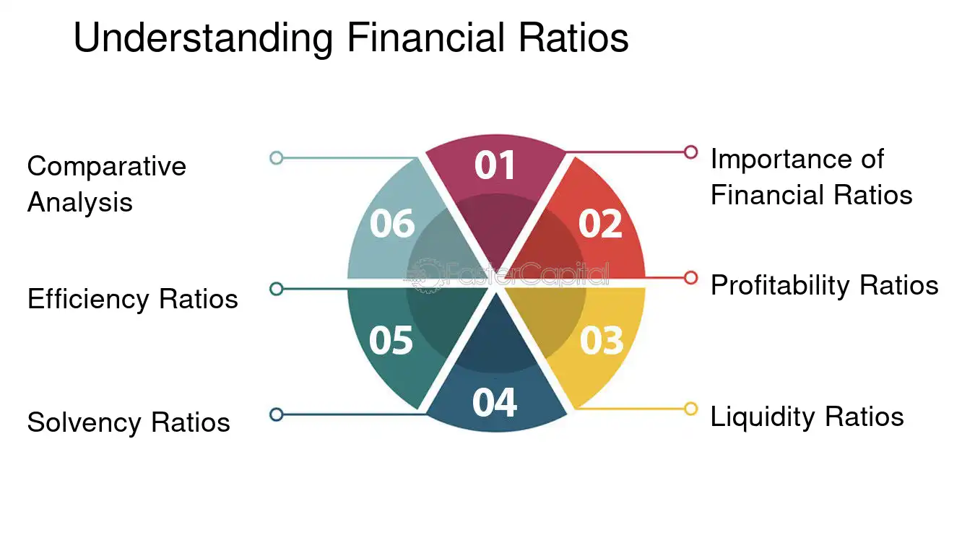
Comparative Analysis

Slide 165
Comparative Analysis
Assessing Short-Term Financial Health
1. current ratio: The current ratio is a widely used liquidity ratio that measures a company's ability to cover its short-term liabilities with its short-term assets. It is calculated by dividing current assets by current liabilities. For example, if a company has current assets of $500,000 and current liabilities of $250,000, the current ratio would be 2. This indicates that the company has twice as many current assets as current liabilities, suggesting a strong liquidity position.
2. quick ratio: The quick ratio, also known as the acid-test ratio, provides a more stringent assessment of a company's liquidity. It excludes inventory from current assets since inventory may not be easily converted into cash in the short term. The quick ratio is calculated by dividing quick assets (current assets minus inventory) by current liabilities. A higher quick ratio indicates a better ability to meet short-term obligations without relying on inventory sales.
3. cash ratio: The cash ratio is the most conservative liquidity ratio as it measures a company's ability to cover its current liabilities with cash and cash equivalents alone. It is calculated by dividing cash and cash equivalents by current liabilities. A higher cash ratio indicates a stronger ability to meet short-term obligations without relying on other current assets.

Slide 166
Comparative Analysis
4. operating Cash Flow ratio: This ratio assesses a company's ability to generate cash from its core operations to cover its short-term obligations. It is calculated by dividing operating cash flow by current liabilities. A ratio greater than 1 indicates that the company's operating cash flow is sufficient to cover its current liabilities.
5. working capital Ratio: The working capital ratio measures the excess of a company's current assets over its current liabilities. It is calculated by subtracting current liabilities from current assets. A positive working capital ratio indicates that the company has sufficient current assets to cover its short-term obligations.
It is important to note that liquidity ratios should be analyzed in conjunction with other financial ratios and factors specific to the industry and company. While these ratios provide valuable insights into a company's short-term financial health, they should not be viewed in isolation. By considering a comprehensive range of financial metrics, stakeholders can gain a holistic understanding of a company's financial performance and make well-informed decisions.

Slide 167
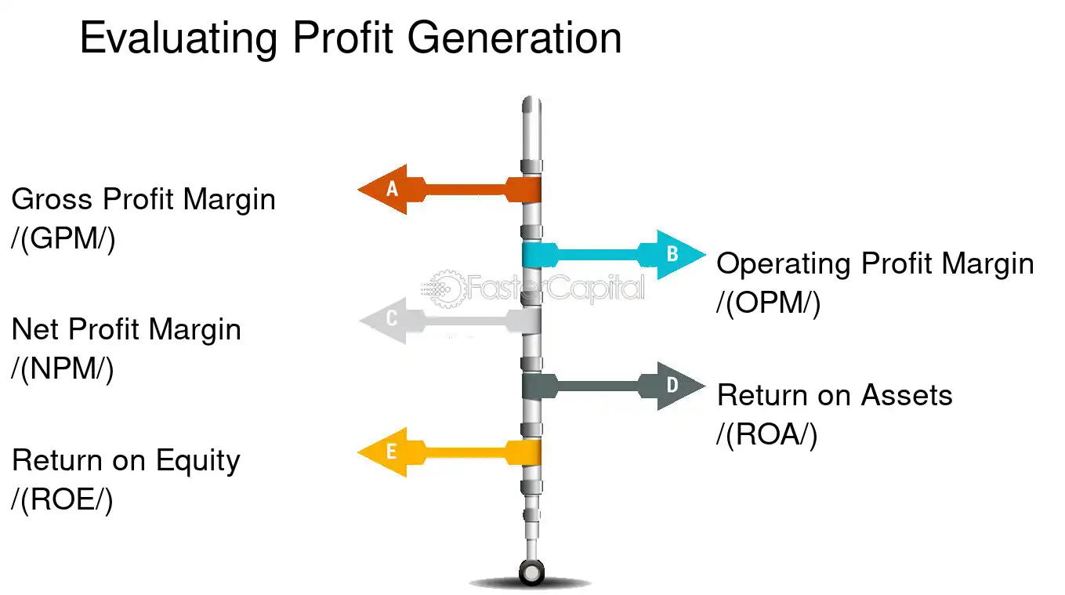
Comparative Analysis
Evaluating Profit Generation

Slide 168
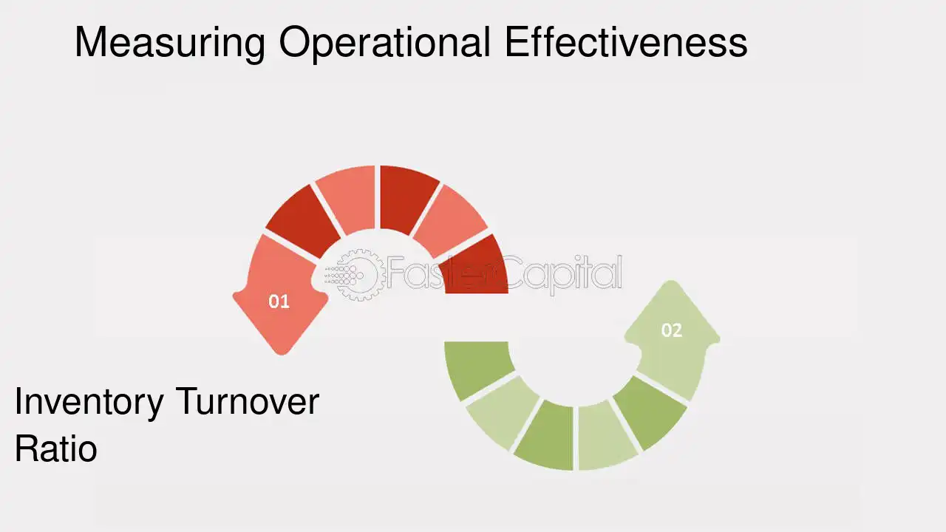
Comparative Analysis
Measuring Operational Effectiveness

Slide 169
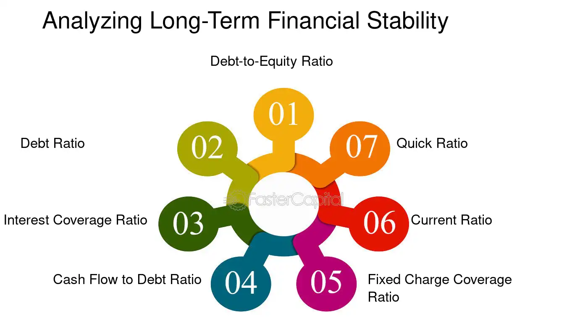
Comparative Analysis

Slide 170
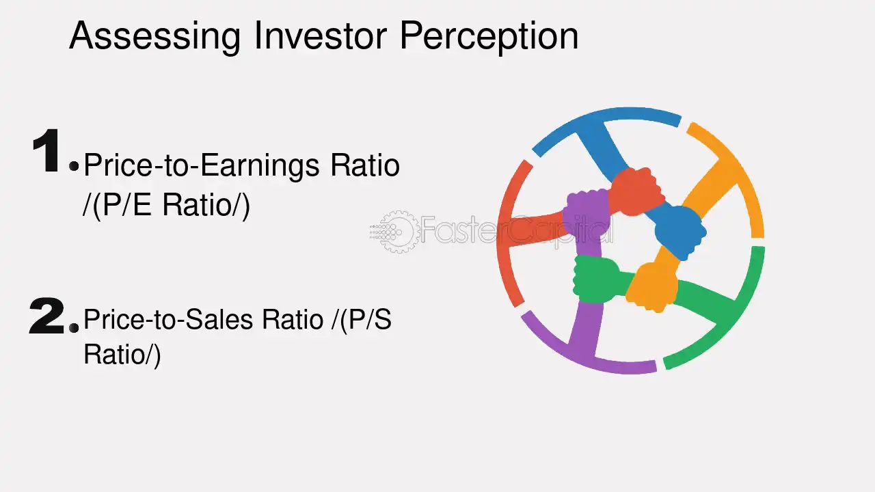
Comparative Analysis

Slide 171
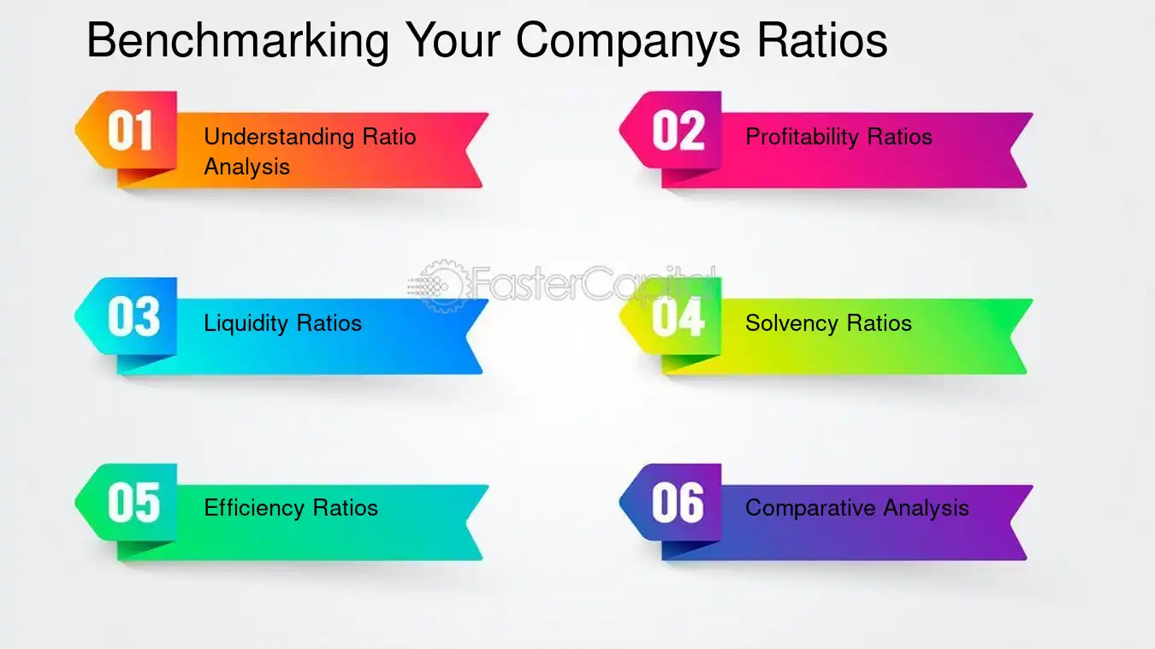
Comparative Analysis

Slide 172
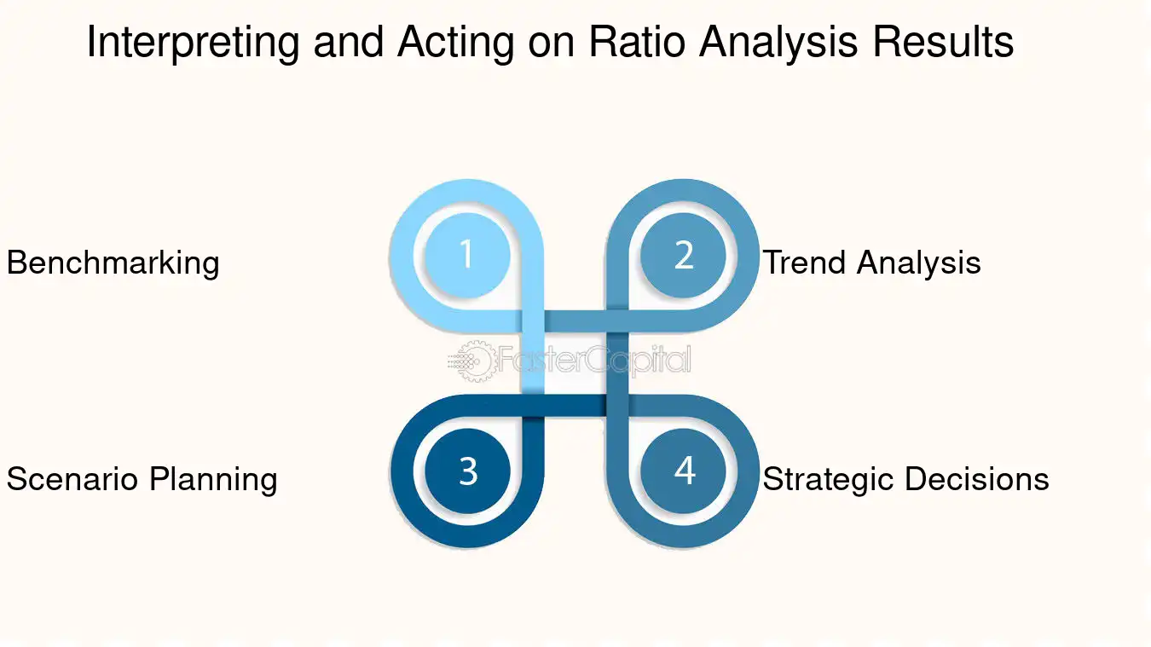
Comparative Analysis

Slide 173
Summary
We have covered the following topics in this lecture:
Numerical Problems on ratios analysis
Current Ratio
Net Working Capital
Acid test or quick ratio
Return on assets

Slide 174
Prerequisite and Recap
Introduction & Meaning of Ratio Analysis
Usefulness of Ratio Analysis
Limitations of Ratio Analysis
Classification of Ratios

Slide 175
Session Learning Objectives
Students will be able to know the following concepts:
Composite Ratio
Comparative financial statements
Advantages of comparative statements
Format of Comparative financial statements

Slide 176
Composite Ratio
Composite Ratio
17. Return on equity capital (roe) :
Net Profit after Taxes / Tangible Net Worth
18. Earnings per share: EPS indicates the quantum of net profit for the year that would be ranked for dividend for each company share held by the equity shareholders.
Net profit after Taxes and Preference Dividend/ No. of Equity Shares
19. Price earning ratio: PE Ratio indicates the number of times its market price covers the Earning Per Share.
Market Price Per Equity Share/Earning Per Share

Slide 177
Composite Ratio
20. Debt service coverage ratio: This ratio is one of the most important ones which indicates the ability of an enterprise to meet its liabilities by way of payment of instalments of Term Loans and Interest thereon from out of the cash accruals and forms the basis for fixation of the repayment schedule in respect of the Term Loans raised for a project. (The Ideal DSCR Ratio is considered to be 2 )
PAT + Depr. + Annual Interest on Long Term Loans & Liabilities
---------------------------------------------------------------------------------
Annual interest on Long Term Loans & Liabilities + Annual Installments payable on Long Term Loans & Liabilities
( Where PAT is Profit after Tax and Depr. is Depreciation)

Slide 178
Exerciese-1
Numerical
LIABILITES
Capital 180
Reserves 20
Term Loan 300
Bank C/C 200
Trade Creditors 50
Provisions 50
800
ASSETS
Net Fixed Assets 400
Inventories 150
Cash 50
Receivables 150
Goodwill 50
800

Slide 179
Numerical
What is the Net Worth: Capital + Reserve = 200
Tangible Net Worth is: Net Worth - Goodwill = 150
Outside Liabilities : TL + CC + Creditors + Provisions = 600
Net Working Capital: C A - C L = 350 - 250 = 50
Current Ratio : C A / C L = 350 / 300 = 1.17 : 1
Quick Ratio : Quick Assets / C L = 200/300 = 0.66 : 1

Slide 180
Comparative financial statements
Comparative financial statements
Comparison Compare
How to compare?
Matching, the similarities and dissimilarities
What do you need to compare?
Two or more things, facts, persons etc
What is the objective of comparison? To ascertain the difference
Why do we compare?
To ascertain which is good/bad?
To ascertain the favorable/unfavorable changes
To ascertain the efficiency and effectiveness
COMPARATIVE STATEMENTS ARE USED FOR COMPARISON

Slide 181
Comparative financial statements
Statements which summarise and present related accounting data for a number of years incorporating therein the changes (absolute or relative or both) in individual item
Figures of two or more period are placed side by side to facilitate comparison
Tool used for analysing financial statements
Aims to study the changes in individual items when compared to the previous year
On the basis of the changes, valid conclusions on financial condition and/or profitability, strengths and weaknesses etc., of the firm
The changes can be shown either in absolute or relative terms or both

Slide 182
Comparative financial statements
Comparative financial statement show:-
Accounting variables in their current and previous values (values for comparison)
Changes (increase / decrease) in the values of individual items
Changes (increase / decrease) in percentages of the individual items.

Slide 183
Advantages of comparative statements
Advantages of comparative statements
Facilitates inter-firm and inter-period comparisons.
Highlights the trends in different accounting variables relating to performance, efficiency, and financial position.
Helps to identify weaknesses in operating efficiency, financial conditions, etc and to take appropriate remedial actions.

Slide 184
Disadvantages of comparative statements
Disadvantages (limitations/demerits) of Comparative statements
Frequent changes in accounting principles, conventions, methods, policies, etc., make inter-period comparison difficult.
Differences in age, size, and lack of uniformity in accounting policies and practices make inter-firm comparison difficult.

Slide 185
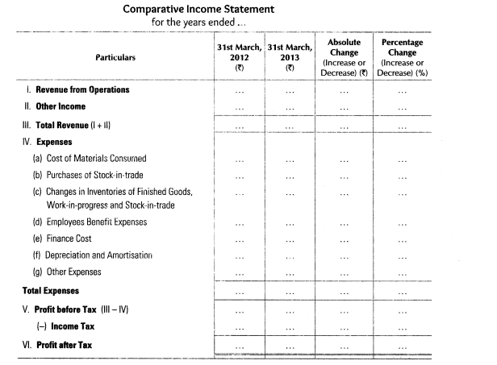
Format of Comparative Balance Sheet
Source: www.theaccounting.com

Slide 186
Summary
We have covered the following topics in this lecture:
Composite Ratio
Comparative financial statements
Advantages of comparative statements
Format of Comparative financial statements

Slide 187
Prerequisite and Recap
Accounting
Numerical Problems on ratios analysis
Current Ratio
Net Working Capital
Acid test or quick ratio
Return on assets

Slide 188
Session Learning Objectives
Students will be able to know the following concepts:
Trial Balance
Purpose of Trial Balance
Methods of Preparation of Trial Balance
Format of Trial Balance

Slide 189
Common-size financial statements
Common-size financial statements:
Financial statements in which items reported are converted into percentages to some common base. In the income statement, total sales will be taken as the base for conversion, and all items in the income statement are converted and expressed as a percentage of sales. In the balance sheet, the total of assets or liabilities will be taken as the common base and all items in the balance sheet are expressed as a percentage of total assets or liabilities.

Slide 190

Format of Common Size Income Statement
Source: www.theaccounting.com

Slide 191
Trend Analysis
Trend Analysis
Another tool used for analysis and interpretation
Trend means “tendency”
Trend analysis means “review and appraisal of tendency in accounting variables.”
Helps in analyzing long-term trend of various business factors – helps in budgeting and forecasting
Helps in ascertaining favorable or unfavorable trend in business
Trend analysis can be performed through:- (a). Trend ratios and (b). Graphs

Slide 192
Trend Analysis
Trend Ratios or Trend Percentages
Ratio expresses a mathematical relationship between two figures. Expression of one figure in terms of another one
Trend ratios/percentages refer to the expression of an arithmetical relationship in which each item of several years bears the same item of ‘base year’.
For calculating trend ratios/percentages, one year is taken as the “base,” and then ratios or percentages are calculated using the figure of the base year as the “base.”
Trend % = P1/P0*100
Where
P₁ = Values of Current Year P₀ = Values of Base Year

Slide 193

Trend Analysis

Slide 194
Course Objective
To enable students to understand information contained in the published financial statements of companies and other organizations.
It includes the preparation of accounting statements, but their uses and limitations will also be emphasized.

Slide 195
Course Outcome
CO3. Create and prepare financial statements using generally accepted accounting principles.
CO4. Utilize the technology (such as computers and information databases) in facilitating and enhancing accounting and financial reporting processes.
CO5. Analyse, interpret and communicate the information in basic financial statements and explain the limitations of such statements.

Slide 196
Prerequisite and Recap
Composite Ratio
Comparative financial statements
Advantages of comparative statements
Format of Comparative financial statements

Slide 197
Faculty Video Links
https://youtu.be/Y4azRCTTWoU
https://youtu.be/exgufyNpLsY
https://youtu.be/T_ROCN-Clbk
https://youtu.be/pLc4IMw2X5E

Slide 198
Daily Quiz
1. When the concept of ratio is defined in respected to the items shown in the financial statements, it is termed as a) Accounting ratio b) Financial ratio c) Costing ratio d) None of the above
2. The relationship between two financial variables can be expressed in: a) Pure ratio b) Percentage c) Rate or time d) Either of the above
3. Liquidity ratios are expressed in a) Pure ratio form b) Percentage c) Rate or time d) None of the above

Slide 199
Daily Quiz
4. Which of the following principles assumes that a business will continue long?
(A) Historical cost
(B) Periodicity
(C)Objectivity
(D)Going concern
5. Which of the following users assesses the attractiveness of investing in a business?
(A) Tax authorities
(B) Financial analysts
(C) Bank
(D) Employees

Slide 200
Weekly Assignment
Q.1 List out the current ratios.
Q.2 Explain the market capitalization ratios and solvency ratios.
Q.3 Throw the light on common size statement of a company.
Q.4 Trend analysis shows the performance of the company. Justify it.

Slide 201
MCQ s
1. When the concept of ratio is defined with respect to the items shown in the financial statements, it is termed as a) Accounting ratio b) Financial ratio c) Costing ratio d) None of the above
2. The relationship between two financial variables can be expressed in: a) Pure ratio b) Percentage c) Rate or time d) Either of the above
3. Liquidity ratios are expressed in a) Pure ratio form b) Percentage c) Rate or time d) None of the above

Slide 202
MCQ s
4. Which of the following principles assumes that a business will continue long-term?
(A) Historical cost
(B) Periodicity
(C)Objectivity
(D)Going concern
5. Which of the following users assesses the attractiveness of investing in a business?
(A) Tax authorities
(B) Financial analysts
(C) Bank
(D) Employees

Slide 203
MCQ s
6. Which of the following statements are true about Ratio Analysis? A) Ratio analysis is helpful in financial analysis. B) Ratio analysis is helpful in communication and coordination C) Ratio Analysis does not help identify weak spots of the business. D) Ratio Analysis is helpful in financial planning and forecasting. a) A, B and D b) A, C and D c) A, B and C d) A, B, C, D
7. The ratio analysis is helpful to management in making several decisions, but as a mechanical substitute for judgment and thinking, it is worse than useless.
a) True b) False
8. Profit for the objective of calculating a ratio may be taken as a) Profit before tax but after interest b) Profit before interest and tax c) Profit after interest and tax d) All of the above

Slide 204
MCQ s
9. The 3 Ps, i.e. the three objectives of analysis and interpretation of financial statements are : Progress, Position and Prospects. a) True b) False
10. Comparison of financial statements highlights the trend of the _________ of the business. Three Ps, i.e., the three objectives of analysing and interpreting financial statements, are Progress, Position a) Financial position b) Performance c) Profitability d) All of the above
11. Analysis of any financial Statement comprises a) Balance sheet b) P&L Account c) Trading account d) All of the above

Slide 205
Glossary Question
Attempt all the parts: please pick the correct option from Glossary
(i) Current ratio = (…………………/Current liabilities )
(ii) The ideal current ratio is .......
(iii) The ideal liquid ratio is .......
(iv) Liquid assets = ....... – (Stock + prepaid expenses)
Cash, Debtors, Bank, B/R, 2,1, current asset

Slide 206
Old Question Papers
MM:100
SECTION A
Attempt all questions in brief. 2 x 10 = 20
What is Financial Accounting?
Define Net Sales and Net Purchases.
Explain Goodwill and Copyright.
What is dividend?
Explain provisions.
What is a Comparative Balance Sheet?
Explain the term solvency of a firm.
What is Schedule of Changes in Working Capital?
Discuss the concept of cash.
What is depreciation?
Source: www.aktuonline.com

Slide 207
Old Question Papers
SECTION B
Attempt any three of the following: 10 x 3 = 30
Discuss various conventions of Accounting.
What are final accounts? Briefly discuss the uses and limitations of final accounts.
What do you understand by Analysis and Interpretation? Explain various tools of analysis of financial statements.
Explain in brief various statements that are prepared in fund flow Analysis. Show the format of each statement.
Differentiate between find flow and cash flow analysis which one is more beneficial for a firm.
Source: www.aktuonline.com

Slide 208
Old Question Papers
SECTION C
Attempt any one part of the following: 10 x 1 = 10
What is the importance of Accounting? Also discuss various types of accounting.
Discuss the role and objectives of International and Indian Accounting Standards.
Attempt any one part of the following: 10 x 1 = 10
What is Journalizing? Explain the concept of Ledger posting and balancing of accounts.
Discuss the adjustment entries. Give any five adjustment entries.
Source: www.aktuonline.com

Slide 209
Old Question Papers
What is Ratio Analysis? Explain various ratios and discuss which type of ratios is used in calculating profitability and liquidity of a firm.
Attempt any one part of the following: 10 x 1 = 10
What is a Balance Sheet? Briefly explain Marshalling of Balance sheet with example.
“Fund Flow analysis is an effective tool of managing working capital in a firm.” Explain.
Attempt any one part of the following: 10 x 1 = 10
Elaborate various types of activities that are considered in a Cash Flow Analysis.
What is inventory? Explain various types of inventory.
Source: www.aktuonline.com

Slide 210
Old Question Papers
Attempt any one part of the following: 10 x 1 = 10
State the final accounts. Briefly discuss the uses and limitations of final accounts.
Discuss the importance of Accounting. Also, discuss various types of accounting.
Source: www.aktuonline.com

Slide 211

End Semester Question Paper Template

Slide 212

End Semester Question Paper Template

Slide 213

End Semester Question Paper Template

Slide 214
Expected Questions for the University Exam
1. Discuss the Analysis and Interpretation. Explain various tools for the analysis of financial statements.
2. Define Ratio Analysis. Explain various ratios and discuss which type of ratios are used to calculate the profitability and liquidity of a firm.
3. State the Balance Sheet. Briefly explain Marshalling of Balance sheet with example.
4. Explain in detail various methods of analysing a firm’s financial statements.

Slide 215
Summary
We have covered the following topics in this lecture:
Trial Balance
Purpose of Trial Balance
Methods of Preparation of Trial Balance
Format of Trial Balance

Slide 216
References
Text Books
1) Maheshwari S.N &Maheshwari S K – A textbook of Accounting for Management (Vikas, 10th
Edition)
2) Essentials of Financial Accounting (based on IFRS), Bhattacharya (PHI,3rd Ed)
3) Khan and Jain - Financial Management (Tata McGraw Hill, 7th Ed.)
4) PC Tulsian- Financial Accounting (Pearson, 2016)
5) Dhamija - Financial Accounting for managers: (Prentice Hall, 2nd Edition).

Slide 217
References
Reference Books
1) Narayan swami - Financial Accounting: A Managerial Perspective (PHI,5th Ed)
2) Dhaneshk Khatri- Financial Accounting (TMH,2015)
3) Ambrish Gupta - Financial Accounting: A Managerial Perspective (Prentice Hall, 4th Edition)
4) Ramchandran & Kakani - Financial Accounting for Management (TMH, 2nd Edition).
5) Mukherjee - Financial Accounting for Management (TMH, 2nd Edition).

Slide 218
Thank You

